Slide 1
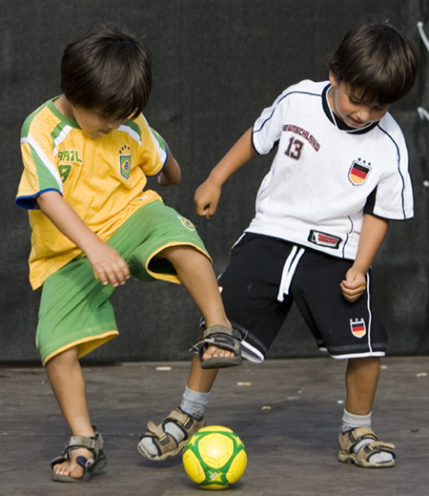
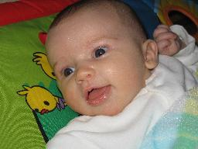
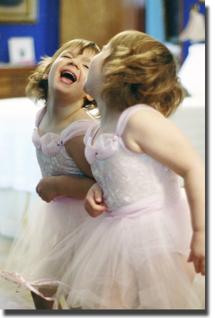
Introduction to pediatric nursing
Kim Martin, RN, MSN,
Nursing Instructor
Central Pennsylvania’s Community College HACC
Nursing 101; Summer 2012

Slide 2
Growth and Development
Growth = increase in physical size of whole or any parts measured by inches/centimeters or pounds/kilograms
Development = progressive increase in skill and capacity of function
Notes:
Growth through cell multiplication and differentiation.
Development = includes psychosocial, cognitive and moral aspects. We will discuss all in detail. Development is change over lifespan.
Occurs as a result of culture and hereditary background. Love and care are essential to development.
G&D is individualized = need to stress to parents not to compare.
Children are competent. They possess qualities that ensure their survival. Newborns cough/sneeze/suck/swallow/breath/cry to elicit care taking responses from adults.

Slide 3
Terms to Know
Newborn (neonate) Birth to 4 weeks
Infant 4 weeks to 1 year
Toddler 1 to 3 years
Preschooler 3 to 6 years
School-Aged 6 to 10 years
Adolescent 11 to 18 years
Notes:
Before we start let’s define each age group that we will discuss. We will break these down and look at each age group and the specific growth and development of each.

Slide 4
Growth and Development
Always orderly and sequential
Directional
Unique
Becomes increasingly differentiated
Becomes increasingly integrated and complex
New skills predominate
Basis for assessment
Anticipatory guidance to parents
Notes:
Predictable universal timetable (learn to crawl before they walk)
2 pathways are seen (next slide)
Always follows a specific pattern, but no two individuals’ progress is identical. (some kids name 4 colors by 3 yrs., other cannot name any until 4 yrs.)
Responses become more specific and skilled as child grows (toddler will fall frequently, because they don’t have balance and dexterity to prevent this, while an older child can balance and pedal a bicycle
As new skills are gained, more complex skills are learned (tossing a large ball to catching a baseball with a glove)
There is a strong drive to practice and perfect each new ability. Learn one thing at a time and then move on. (Verbal skills may stall, while learning to walk)
Normal pattern provides basis for assessment
Provides info for anticipatory guidance for parents

Slide 5
Patterns of Growth
Cephalocaudal (head to toe)
Proximodistal (central to distal)
Notes:
Cephalocaudal = area closest to brain and head develops 1st. Followed by trunk and feet
head control, sitting, crawling, walking
sits before stand; crawl before walks
Proximodistal = inside out. Controlled movements closest to body center (trunk and arms) develop before controlled movements distant to body (fingers). Grasp changes from using hand to just fingers

Slide 6
Screening Tools for G & D
Growth charts
Plot height, weight, and head circumference
Compare to other children same age
Reported as percentiles
Denver Developmental II Screening Tool
Birth to age 6 years
Evaluates personal/social, fine motor, gross motor, and language development
Notes:
See Appendix F in book pp. 450 – 459
50% = 50% of children are smaller and 50% are taller
95% = 5% are heavier and 90% are lighter
See Appendix G pp. 460 – 461

Slide 7
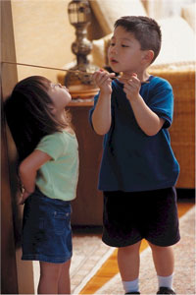
Physical Growth
Weight
Height
Skeleton
Teeth
Muscle, Fat, and Skin
Brain and Nervous system
Notes:
Weight is good index of health
weigh at each visit, should see steady increase, rate of weight gain is determined by heredity and type and amount of food consumed
Height is based on skeletal growth
see most rapid change during infancy and puberty
also determined by heredity and nutrition
Skeleton – bone growth is an indicator of biological age
Ossification = bones forming; changing cartilage to bone (infant mostly cartilage)
Calcification = putting down calcium; hardening bone; bone growth continues until epiphyseal (growth) plates fuse
Pliable = most ROM at birth
in children bone growth is greater than bone destruction
fracture less easily because of more H2O and protein
Teeth – begin to form when fetus is 6 wks.
at birth all baby teeth are formed and a few permanent teeth are forming\
Muscle, fat, skin – more fat as infant; least in puberty
large muscles function better than smaller ones at first
muscle size and strength increase gradually in school-age
body surface greater in relation to weight
Brain and Nerves – evaluate growth by assessing reflexes and abilities
Use Denver Developmental screening to assess
all brain cells present at birth – experience leads to pathways or connections between neurons
(Computer analogy = brain cells at birth are hardware of computer and experiences of child is software that you add to your computer to make it more usable and complex)

Slide 8
Development
Psychosocial
Cognitive
Sexual
Moral
Notes:
Growing children of same age develop at noticeably different rates and even great differences may be completely normal.
These are aspects of development we will discuss in much greater detail
To understand we need to talk about the theorist who have studied and researched children.

Slide 9
Developmental Theories
Psychosocial Erik Erikson
Cognitive Jean Piaget
Psychosexual Sigmund Freud
Moral Lawrence Kolhberg
Notes:
As we discuss these, you will see that they are interrelated.
All of them are occurring at the same time
Each affect and are affected by the others
CNS development is essential for cognitive development
A child cannot be independent to toilet train until aware of urge and able to remove necessary clothing

Slide 10
Psychosocial Development Erik Erikson’s Developmental Tasks
Trust vs. Mistrust 0 – 12 months
Autonomy vs. Shame 12 mo – 3 yrs.
and Doubt
Initiative vs. Guilt 3 – 6 yrs.
Industry vs. Inferiority 6 – 12 yrs.
Identity vs. Role 12 – 18 yrs.
Confusion
Notes:
Erik Erikson Freud’s student; expanded on Freud’s ideas
Added an emotional/social component
Emphasized individuality and maturation across the life-span
looked at 8 critical periods of ego development or tasks
The goal is resolution of the task; if not mastered, then maladaptation or mental illness may occur
Complete mastery is not realistic, but each person must master enough at each stage to effectively cope with conflicts later in life
5 are for children, so we will focus on these.
Criticism = biased against women. Does not consider sexual differences
no measurable and observable goals
However it is excellent in health care = can provide situations or opportunities to master each developmental crisis/task

Slide 11
Cognitive Development Jean Piaget
Stage I: Sensorimotor Phase (0 – 2 yrs.)
Object permanence
Separation anxiety
Stage II: Pre-Operational (2 – 7 yrs)
Egocentric
Symbolism
Magical thinking
Stage III: Concrete Operation (7 – 11 yrs)
Concept of conservation
Concrete thinking
Stage IV: Formal Operations 12 – 15 yrs)
Abstract thinking
Notes:
Children grow thru exposure to the world around them
Emphasizes individuality in rate of development

Slide 12
Psychosexual Development Sigmund Freud
Psychosexual Stages
Oral (0 – 18 months.)
Anal (18 months – 3 yrs.)
Phallic (3 – 6 yrs.)
Latency (6 – 12 yrs.)
Genital (12 yrs. – adult)
Notes:
Proposes that adult character traits, behaviors, and thinking are a result of crucial events in childhood
Personality is fully developed by 12 years of age
Everyone develops in a certain manner, at strictly defined ages; development based on relationship with parents only
Criticized: difficult to test
too narrow and simple
no individuality
based on biological drives
no sociocultural influence
Good because it emphasizes the unconscious motivation for behavior
Implications to children = offer pacifiers especially if NPO, offer sucking with painful procedures (pacifier, breast, or bottle)
Need for teething toys
Toilet status of toddler = provide appropriate size potty; DO NOT train if increased stress (new sibling, hospitalization)
Masturbation is NORMAL part of development
DO NOT shame; set limits as to appropriate time and place.

Slide 13
Psychosexual Development Sigmund Freud
Three Components of Personality
Id
Ego
Superego
Notes:
ID – biological and psychological drives
self-centered
major concern is instant gratification
no knowledge of outside reality
goal is pleasure
EGO – mediates the drives of the Id
based in reality
no morals or social rules
goal is reality
Frequent conflict will arise between the 3 parts; resolution of conflict determines status of person’s mental health
SUPEREGO - moral behavior
accumulation of societal rules and personal values
idealistic
goal is perfection

Slide 14
Moral Development Lawrence Kohlberg
Three Levels of Development
Pre-conventional Stage (pre-moral)
4 – 7 years
Conventional Stage
7 – 12 years Conscious Developed
Post-conventional Stage (principled level)
12 years and up Internalized ethical standards
Notes:
Kohlberg was interested in how people justified and supported their decisions
Learning builds on previous stage
Stages are experienced in exact order; cannot back track
Moral development can be promoted via formal education (Anyone see this today?)
Criticism = not cultural or gender sensitive
Health implication = important to give clear rationale for treatments so child can internalize answers.

Slide 15
Growth and Development
Influencing Factors
Culture
Heredity/Sex
Family dynamics
Environment
Nutrition
Notes:
Heredity = what we inherit = genes, chromosomes, certain bone structure; dominant and recessive gene traits
small parents = small child (usually)
Sex chromosomes make us male or female. Different pattern of G&D (SHOW GROWTH CHARTS)
Environment = poverty, educational level of parents, love, caring, nurturing, hygiene – all very important to G&D
Nurture = environmental influences on development
Nutrition = large part of G&D. Poverty and availability of food; quantity and quality of food and H2O
Also influenced by nationality, race and ordinal position in family
Nature vs. Nurture debate

Slide 16
Culture and the Child
Individuals share
Values
Beliefs
Information
Ingrained orientation to life
Serves as frame of reference
Notes:
Culture = US, Central PA, and family
Values = constructs that give meaning to our lives
Values are motivational preferences
values are influenced by religion, family, and society
Aesthetic value = beauty
Monetary value = money
Beliefs = what we perceive to be true, false, right, wrong, moral, amoral
Based on values!
Morality is behavior in accordance with custom or tradition and reflects personal or religious beliefs.
Culture = ingrained orientation to life = it is learned, integrated, social and satisfying
Learned from family and interaction with their extended family and family friends.
Frame of reference of individual’s perception and judgement

Slide 17
Culture and the Child
People differ from another
Way they think
Way they solve problems
Way they perceive structure of world
Definition of health
Causes of health problems
Notes:
The way a person perceives structure is based on where they are.
The US views self differently than other cultures see us.

Slide 18
Culture and the Child
Will determine child’s
Food they eat
Language they speak
Clothing they wear
Ideals of behavior
Religious preferences
Current and future social roles
Notes:
Different foods in different cultures
Different meaning to meals and food
Language = child is born and can learn any language = basic foundation is set in first 2 years.
What clothing can they wear? What is acceptable? How much skin can they show? Dresses or pants?
Ideals of behavior = huge issue = limit setting is part of this = our culture will dictate the limits we set for our children
seen and not heard or inquisitiveness is encouraged; sit quietly or exploration encouraged
Religious preference of family = 1st in-grained belief
Social roles = what roles are acceptable: homosexual males; girls can be come MD/lawyer; who is primary breadwinner in a family?

Slide 19
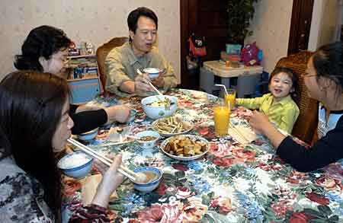
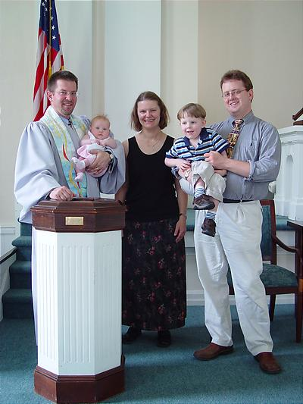
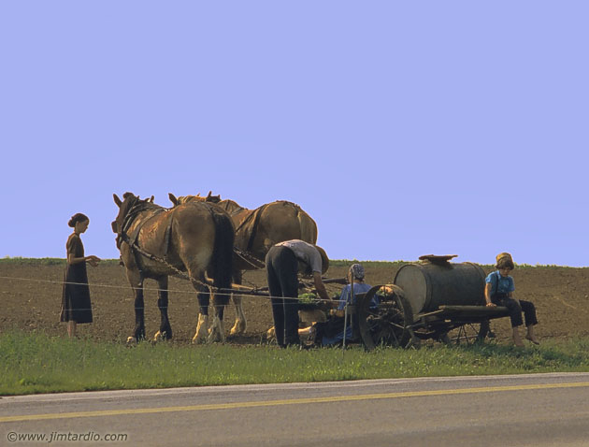
Notes:
Cultural norms can be stereotyped, so be careful. May not be accurate for all families.
HAVE CLASS DO PEDIATRIC CULTURAL EXERCISE
Have class members share child rearing beliefs and health care ideas from their culture.

Slide 20
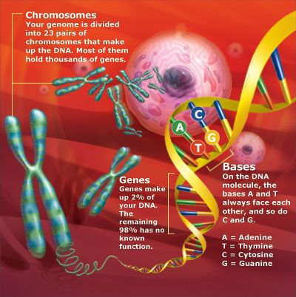
Heredity/gender
Born with 23 pairs of chromosomes
Our genotype makes us who we are
Boy vs. girl
Notes:
Rate of growth
Color of hair, eyes, and skin
Abilities and talents
Gender (Male or female)
Do we treat girls and boys differently? YES!! From birth; parents are more active and rough with boys; talk and cuddle more with girls
Is this difference in parents or how parents react to the child’s behavior?
The toys we buy for girls vs. boys
But is this all that determines who a child will become? How they will grow and develop?

Slide 21
Childhood Disorders and ethnicity
Black American = Sickle Cell
European American = Cystic Fibrosis
Jewish = Tay-Sachs
Amish = Hemophillia B, MSUD, Ellis-Van Creveld
Northern European = PKU
Japanese = cleft lip/palate
Notes:
Our genes can make us more or less likely to have specific disorders. These diseases are based on racial differences.
Ellis-Van Creveld = inherited form of dwarfism
We also know that genes play an important part in other acquired diseases such as; DM, certain types of cancer (breast and colon), HTN

Slide 22
Family dynamics
Family size
Birth order
Type of family
Nuclear
Blended
Single parent
Homosexual
Cohabitation
Extended
Notes:
Ask students for ideas about how each affects the child
Family size: small = more individual attention; large = interdependence, cooperation
Birth order: first child paves the way; more is expected; less independence
later children have more freedoms; parents more flexible; development may be slower because babied (everyone does for them)
Type of family:
Nuclear: thought to provide most stability for children?
Blended: step family; more common now; may increase stress on parents; may cause intense sibling rivalry
Single parent: parent may feel overwhelmed; may use child as emotional support system/friend; limited resources and time for children
Homosexual: becoming more common; child may experience teasing (STIGMA); no sign. difference found in gender identity and sex role behavior among children; no psychological differences
Cohabitation: same issues as blended or nuclear; legal issues can arise
Extended: several generations living and working together; sharing resources and responsibilities

Slide 23
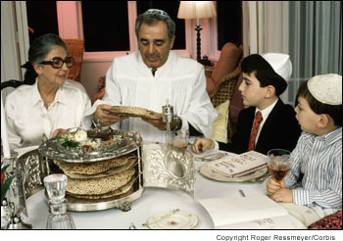
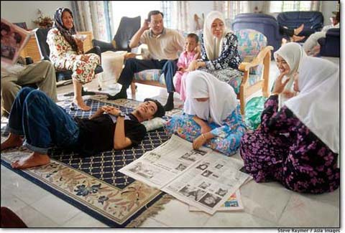
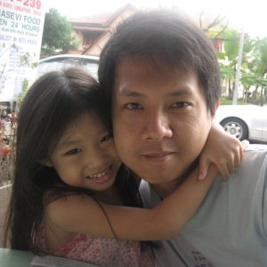
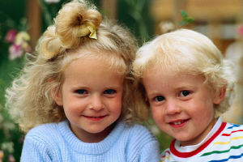
Notes:
Must consider the family as part of the child.
Child depends on parent for certain needs = cannot exist without family.
Family WILL ALWAYS be a part of every assessment, intervention, education, and evaluation

Slide 24
Environment
Prenatal and Perinatal
Socioeconomic status
Family interaction
Home location
Exposure
Notes:
Prenatal care; health of the mother; delivery complications
Money available; education level of parents
Level of stress in family; illness of parent or child; martial discord; sibling rivalry
Inner-city vs. rural
Exposure to both negative and positive things; pollution; lead; music; art; educational opportunities
Nature VS. Nurture
Which has more influence on the child’s G&D?

Slide 25
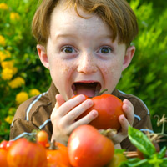
Nutrition
Supports normal growth and development
Important to both physical and emotional development
Each period presents unique challenges

Slide 26
Hospitalization of Infant and Child
Traumatic and disturbing experience
Separation of child from caregiver can have damaging effects
Parents need to be encouraged to stay and made to feel welcome
Children and parents need to be prepared for hospitalization
Notes:
Pediatric hospitals are designed to meet the needs of child and parents
Cheerful – casual atmosphere
Patients wear bright colorful gowns – own clothes when possible
Nurses DO NOT wear white (scares children); see bright colorful scrubs
Colorful bedspreads and walls
Furniture appropriate size for child
ALL TRAUMATIC PROCEDURES ARE DONE IN TREATMENT ROOM, NOT PATIENT ROOM; patient room is SAFE place. Also other children are not disturbed by procedure.
Prepare child at level of their understanding
Parents need preparation for hospitalization and separation
Based on theory that fear of unknown is worse than fear of known (applies to both)
Playroom with toys, computers, video games, movies
Play is a child’s work; they need time and place to play

Slide 27
Hospitalization of Infant and Child
Never lie
Allow choices and freedom
Impose consistent limits
Use familiar terms
Attitude of confidence
Allow child to see and handle strange and potentially frightening objects
Integrate play into nursing care and procedures
Notes:
Will feel betrayed if you lie and loss trust in you – prepare immediately prior to procedure – no needless worry – keep explanations simple and on their dev level.
Remember 4-5 year old can understand simple directions (not too complex)
Be consistent in behaviors toward child.
Allow freedom on unit within limits.
ALLOW CHOICES – keep them simple and offer only 2 choices
NEVER – “Do you want to take a nap? Answer will always be NO!
Instead – “Do you want to take a nap now or after a story?”
You must pose limits on behavior (Clinic when doing finger stick “You may cry or scream, but you may not move or bite.”)
Convey attitude of confidence, expecting cooperation (Don’t let them see you sweat).
Praise cooperation and communicate disproval of behavior not child.
Play = business of childhood, promotes G&D, physical, mental, emotional, and social aspects.
Climbing on jungle gym = coordination of muscles, exercises all body parts
Imagination = in jungle swinging limb to limb “I am a monkey”
Learn colors, shapes, sizes, and textures
NEED TO PLAY EVEN DURING ILLNESS

Slide 28
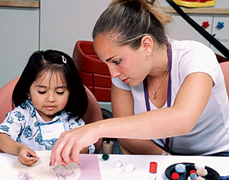
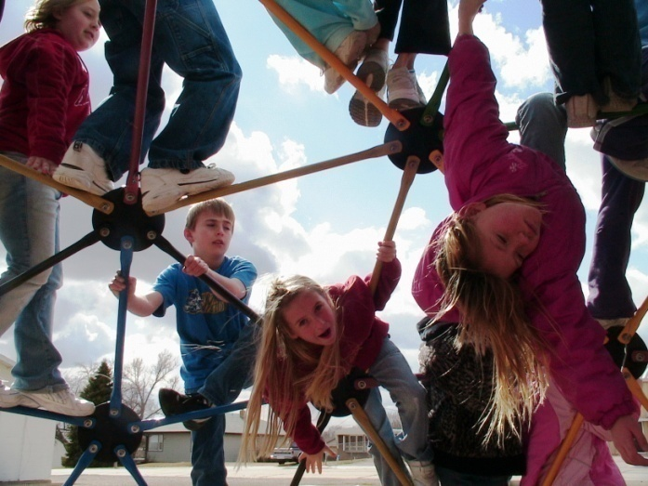
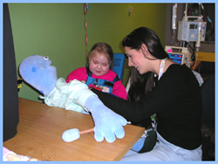
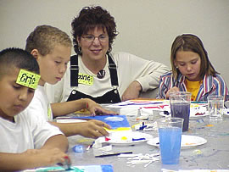
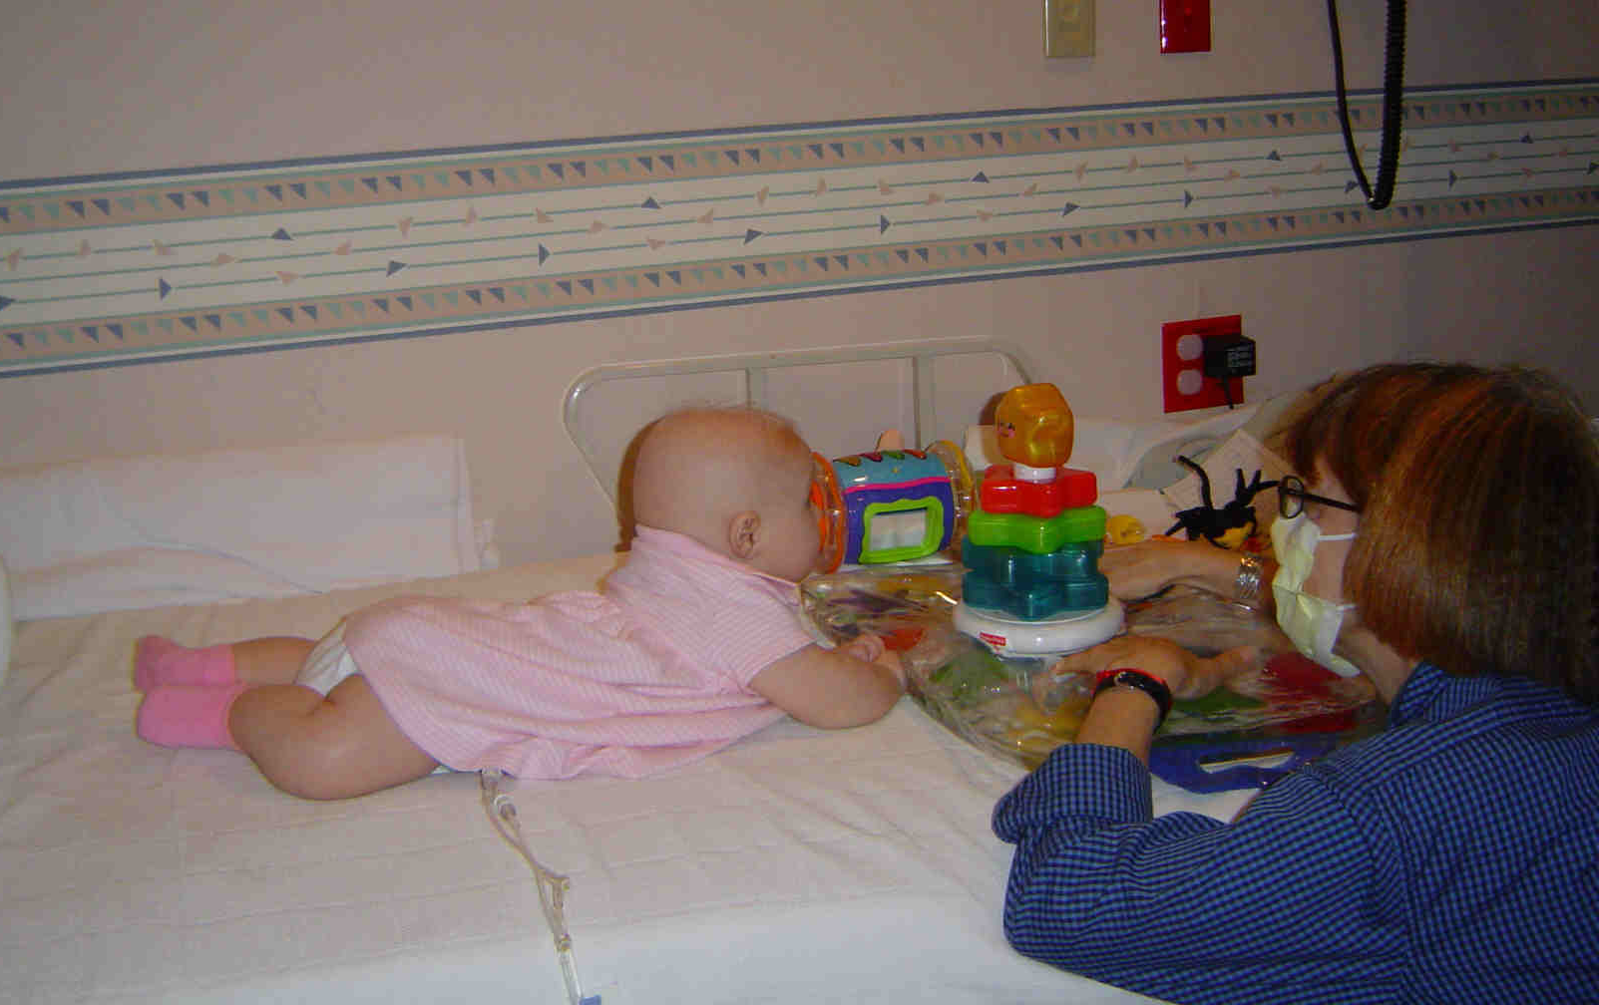
Purposes of Therapeutic
Play
Notes:
Child Life Therapist
specially trained person to assist child and family cope with illness and hospitalization.
Purpose of therapeutic play: prepare child for procedures
to express feelings and fears
help maintain sense of control and normalcy
promote G&D
provide music, playmate,
push/pull toys = hand/eye coordination
musical instruments = fine motor; movement of fingers
blowing bubbles = strengthen oral muscles and deep breathing
act out feelings with dolls or other children
art therapy = express feelings through art (PICTURES)
Over stimulation can be hazardous – may need to conserve energy
Always assess – balance between play and rest

Slide 29
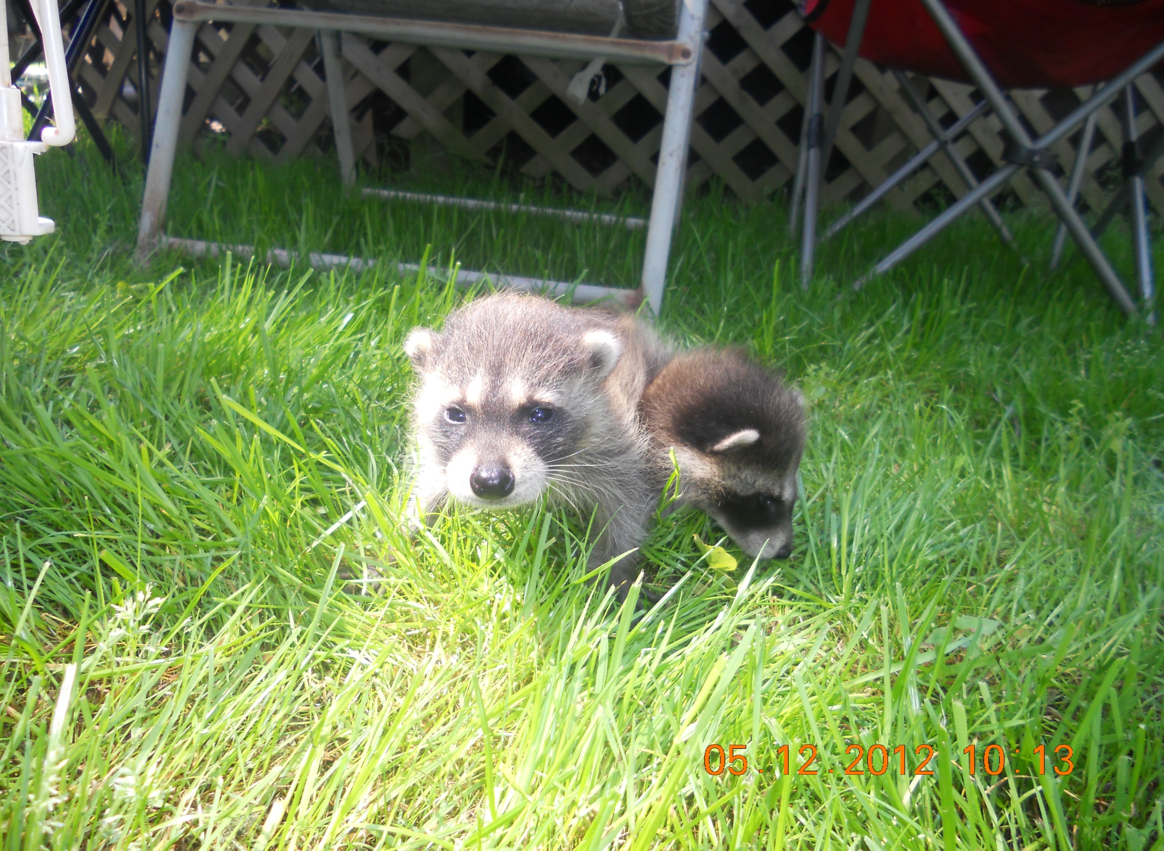
PLAY IS A CHILD’S WORK

Slide 30
Hospitalization of Infant and Child
Safety
Consistent routine
Familiar objects from home
Don’t criticize parents; teach by example
Family visits and participation
Nurse entire family
Notes:
Safety applies to all age groups
Major concerns
crib rails up when unattended
hand on child at all times if turning back to child
Hand washing before and after care
ID child with arm band
check w/c and stretchers before you put child in or on one
no crib near outlet
inspect all toys
meds out of reach
do not prop bottles
do not use w/c as toy
Separation is difficult for both parents and child (esp. toddler)
Parents may be torn between work responsibilities, other siblings, and ill child
Remind them that everyone is afraid sometime; they are not alone

Slide 31
Hospitalization of Infant and Child
Major causes of stress
Separation
Pain
Fear of body intrusion
Notes:
Separation = feel loss of control and powerless
Pain = fear of injury and pain, especially if previous experience; allow child to play with safe equipment (tongue blade, stethoscope)
Body intrusion = fear of mutilation and dramatic body changes. Very active and vivid imaginations. Remember imagination can be much worse than reality; especially with children.

Slide 32
Hospitalization of Infant
Bonding with parents is essential
Parents’ presence and participation
Separation anxiety in older infant
Notes:
Remember trust vs. mistrust is primary developmental task at this age and parents (primary caregivers) are essential to that process.

Slide 33
Hospitalization of Toddler
Separation Anxiety at its peak
Separation very emotionally painful for toddler
Notes:
Sep anxiety beginning at 8 months and continuing though most of toddler years
Toddlers world revolves around them and parents especially primary caregiver (mother)
Toddlers with continuous secure relationship with parents will react more violently to separation BECAUSE THEY HAVE MORE TO LOSS
May have long term effects if not handled properly

Slide 34
Hospitalization of Toddler
Three stages of separation
Protest – crying, clinging, refusing comfort
Despair – sad, lonely, apathetic, listless
Denial – when caregiver visits child rejects them. Slow to accept again. Memory of abandonment lingers
Notes:
Major issue for toddlers; will see some in older children also
Separation anxiety
Protest can last hours to days
protest loudly – will watch and listen for mother, cry is pitiful and continuous, call for mommy or daddy, wonder why she doesn’t answer, may verbally and physically attack strangers, rejects strangers, may physically try to prevent parents from leaving.
Despair (variable time frame) anger turns to despair – look sad and lonely, may refuse to eat, depressed and less active, often interpreted as acceptance
denial (rarely seen) – child will deny need for mother by appearing detached and uninterested in her visits. On surface appears settled in, only disguised to prevent further emotional pain
MUST NOT JUST leave must prepare child for separation (harder on parents this way)

Slide 35
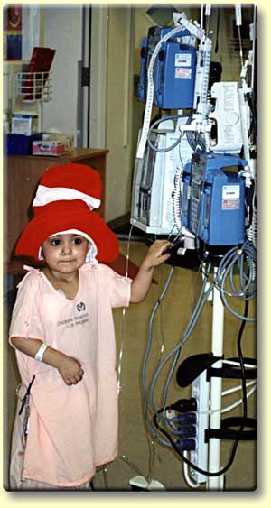
Notes:
Parental visits are EXTREMELY important and essential – even though process of separation and reunion is painful
Parents need education concerning child’s response

Slide 36
Hospitalization of Toddler
Nursing Interventions
Transitional objects
Peek-a-boo
Parent participation
Rooming in
Home habits
Pictures of family member
Notes:
Use transitional object for security = blanket, stuffed toy
Have parent assist in procedure if child if having problems coping
When 1st meeting toddler speak to doll or toy first
Play repetitive games with disappearance and return (peek-a-boo)
Don’t let parents sneak away from child – let child see them as they leave – caretaker distracts (Do not destroy trust)
Encourage rooming in when possible (not always in ICU)
Home habits = record and utilize

Slide 37
Hospitalization of Toddler
Nursing Interventions
No concept of time
Expect regression
Basic fear
Loss of bodily control
Toddlers want to be in control!
Notes:
Discuss time in terms child can understand (when Barney is over or after lunch)
Regression = if toilet trained may have accidents
Basic fears = warn child if something will hurt
Be honest
Allow some independence with supervision
Allow out of crib, if possible
May regress = abandon recently acquired skill and will demand assistance with tasks previously mastered. We need to educate parents that this is normal and except these behaviors

Slide 38
Hospitalization of Toddler
Incorporate play
Magical thinking
Fantasy
Play with equipment and check it out
Use age appropriate communication
Short phases
One idea at a time

Slide 39
Hospitalization of Toddler
Nursing goals
Reassure and educate parents
Maintain toddler’s sense of trust
Incorporate home habits
Overcome fear and anxiety with play
Provide flexible care according to development of child
Notes:
Try to continue with potty habits
Help child overcome fear

Slide 40
Hospitalization of Preschool Child
Less separation anxiety
Fear of body intrusion or mutilation
Consider illness punishment for wrongdoing
Role play and dolls are effective ways to communicate and educate
Limited concept of time
Notes:
Not as threatened
May still see regression at this age
Fear of being hurt and/or mutilated
Intrusion = preschoolers fear body harm, think body is filled with air or fluid and will collapse with puncture like a balloon
Band-Aids are important for this reason
Guilty = especially if accident was his/her fault or told don’t go out or you will get sick
Will act out and imitate health care providers to gain control
Think concrete operations
Still have limited ability to separate fantasy and reality
May feel that their behavior caused their illness (punishment for bad behavior)
Age of developing conscience and may feel guilty
Use dolls or stuffed animals to explain procedures
Erin at surgery center (Operated on her stuffed bear several days later)
DON”T LIE “This will hurt”
Cues – better concept of time, but still need known cues as to when things will occur
“After your nap Daddy will be here”

Slide 41
Hospitalization of School Aged Child
Tolerate separation for short periods of time
Fear of physical nature of illness
Attempt to be brave and not show fear
Watch body language
Need to be industrious
Play very important therapy
Board games, drawing, puppets, role play, models, puzzles, GameBoy
Education
Notes:
Can accept more readily than preschooler
Formal education must continue through illness
Remember industry vs. inferiority; child needs to feel productive
may want to start a collection of things that are meaningful to them (they like to collect things)
my cards following my open heart surgery at age 7 yrs. (I still have them)
Requires cooperation of school, teachers, parents, and healthcare providers
Attempts to be brave, may not show fear in situation
Watch for nonverbal cues
Drawing pictures and talking about them can help them express their concerns and fears
Same sex caregiver for bathing because of modesty; ensure privacy and provide as much independence as possible

Slide 42
Hospitalization of Adolescent
Threat to body image
Privacy
Abstract thinking and solve problems
Include in plan of care
Anxiety r/t:
Loss of control
Loss of independence
Fear of altered body image
Separation from peer group
Notes:
Talk with them, not at them or to parents
Need to make own decisions with parental input

Slide 43
Hospitalization of Adolescent
Room mate selection is important
Must stay connected with peer group
Support developing body image
Allow control and independence
Notes:
Reassure concerning incisions; healing will occur with minimal scarring
Major issue will be loss of control, loss of independence and loss of ID
Allow as much control and independence as possible

Slide 44
Assessing Infant and Child
Vital signs
Growth
Height and Weight
Head Circumference
Chest Circumference
Growth Charts
Notes:
Vital signs are obtained on all children at each visit and compared with norms for age
Pages 31 – 34 discuss VS in children and norms for age
POINTS TO HELP YOU:
Check apical pulse for 1 full minute, when calm and quiet
Look at abd. for 1 minute when quiet
B/P = explain procedure to toddler or small child as hugging arm. Done on children 3 and over
Temp. = rectal preferred for infants and small children; Do last because invasive = crying
NO glass thermometers
may use skin probe
tympanic NOT recommended in infants and children (questionable accuracy)
5. Ht = can do with infant lying flat with tape or yard stick. Top of head to heels (straighten leg/s)
6. Wt. = naked cover scale with clean paper for each child (water proof is best)
7
Growth charts do not take into account differences for cultural and hereditary back ground

Slide 45
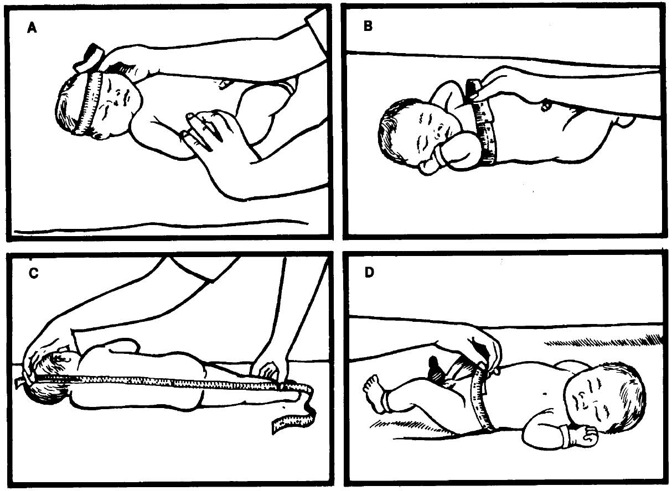
Head circumference
Chest circumference
Crown-to-head recumbent
length
Abdominal circumference
Notes:
Here you see the measurements
Head: paper tape around head above eyebrows and pinnae of ears to occipital prominence up to 36 months of age
Chest at nipple line
When do you think that you would need abd. circ.?

Slide 46
Assessing Infant and Child
General Appearance
Facial expressions
Posture, position, body movements
Hygiene
Nutritional status
Behavior
Development (motor, language, cognitive, psychosocial, etc.)
Notes:
Facial expression = does child smile, cry, grimace, stare blankly? Is expression appropriate for situation and age?
Posture = flexed, extended, flaccid
Hygiene = diaper rash, odor, condition of clothes, clean/dry or dirt/wet?
Nutritional status = appearance, I&O, assess feeding and diet
Behavior = appropriate for age
Development = assess gross and fine motor, describe language, cognitive, and psychosocial by using Denver Developmental Scale

Slide 47
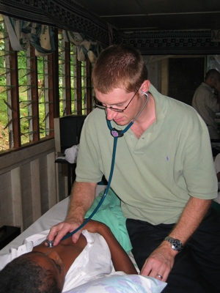
Assessing Infant and Child
Cardiovascular Assessment
Apical HR, rhythm and quality
Color
Peripheral pulses
Edema
Skin turgor
Capillary refill
I&O status
Color of mucous membranes
IV sites and fluids
Notes:
Peripheral pulses = must check femoral pulses bilaterally
What is best way to monitor I&O (fluid level) in infants and children?
DAILY WT.
Not toilet trained = weight diapers 1 mg = 1 ml of urine

Slide 48
Assessing Infant and Child
Respiratory Status
Rate, depth, rhythm, and quality
Signs of respiratory distress
Less than 6 months are abdominal breathers
Breath sounds
Warm stethoscope
May have to quiet child
Quiet environment
May have child blow a pinwheel
Notes:
What are sign of resp distress in infants and children? Grunting, nasal flaring, retractions, cyanosis
How to calm child?
Try to do when sleeping; pacifier; allow toddler to play with stethoscope; distract with toy; have parents hold on their lap

Slide 49
Assessing Infant and Child
Respiratory Status
Pulse Oximetry
Check site Q2h
Change site Q4h
Apnea monitors
Detect respiratory movements
Cardiopulmonary monitors
A/B monitor (Apnea/Bradycardia)
Notes:
Parents may be afraid to hold and provide care of infant with monitor because of lines
Need to be comfortable yourself and show parents how to hold

Slide 50
Assessing Infant and Child
GI Assessment
Weight (compare with chart)
Amount of breast milk/formula taken Q24h
N/V/D
Bowel movements (color, consistency, pattern)
Sucking ability
Swallowing difficulties
Mucous membranes
Notes:
For G&D to happen you need adequate K cal/day

Slide 51
Assessing Infant and Child
GI Assessment
Inspect abdomen
Listen to bowel sounds
Palpate
Look for hernias
Inspect umbilicus
Inspect rectum
Skin integrity
Rashes
Notes:
Same as adult = Look, Listen, and Feel in all 4 quandrants

Slide 52
Assessing Infant and Child
Genitalia
Inspection
Discharge/Trauma
Rashes
Notes:
Depending on age maybe embarrassed 2 yr. old vs. 13 yr. old
Need to use developmental considerations
Great time to educate/reinforce child and parents about “good touch” vs. “bad touch”

Slide 53
Assessing Infant and Child
Musculoskeletal
Symmetry
Gait
ROM
Shape of bones
Bowed legs (Genu Varum)
Knocked-knees (Genu Valgum)
Knees close together, but feet apart
Mild seen at 2 – 7 yrs. of age
Pigeon toes (toes turning in)
Most common gait problem

Slide 54
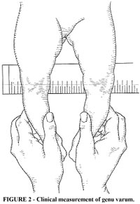
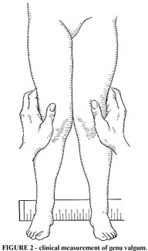
Notes:
Bowed legs (Genu Varum)
Knocked-knees (Genu Valgum)

Slide 55
Assessing Infant and Child
Neurological Assessment
LOC
Behavior
Motor functioning/movement
PERRLA
Pain***
Always look for S&S of pain
Notes:
Change in Behavior is important sign = decreased activity with illness or pain
Pain in children is great area for research in children
Historically not always medicated appropriately for pain control
Lack of nursing and medical education of this topic and myths are primary barriers
JACHO has named pain as the 5th vital sign
Pain history = antiquated notion that children do not feel pain.
Do you think that this is true? What do you think?
Barriers: Myth – children do not feel pain
Myth – infants do not have consequences from painful experiences (recovery is SAME as adult)
Lack assessment skills
Misunderstanding of how to conceptualize and quality pain in young children
Lack of knowledge of pain treatment in children
Addressing pain takes too much time and effort
Fear of adverse reactions to medications (resp. depression or addiction)
Erin and Lyme disease (knee pain)
Personal values and beliefs of healthcare professionals (pain builds character, big boys don’t cry, you’ll get over it)

Slide 56
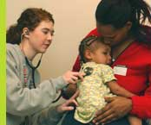
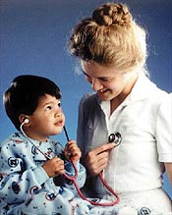
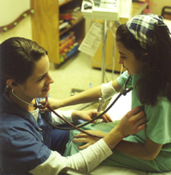
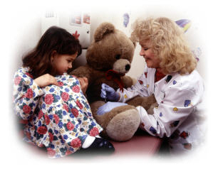
Notes:
Let’s talk about the approach to examine each age group
Get on their level
Get parents involved
Let them play (explore) equipment to be used. (Erin pre-op tour = mask, IV tubing and bag, O2 tubing, rooms, stretchers)
Do examine on stuffed animal first
Approach a shy child by talking to their toy or doll (especially toddler)
Distract with bright objects or toys
Developmental Approach: Let’s look at each age more closely

Slide 57
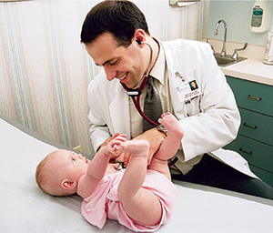
Infant Assessment
Notes:
Infant = trust vs. mistrust = keep parents in view
before 4 – 6 months = may lay on table or bed with parents near
6 – 8 months = separation anxiety = examine in parent’s lap, don’t separate
Examine quiet areas first = heart/lungs/abdomen, then head to toe with ears and throat last
Smile and use gentile voice, but not artificial
Infants don’t mind being undressed, but must keep warm

Slide 58
Toddler Assessment
Notes:
Negativism = NO They need to say it! Part of developing autonomy
Never ask child can I, may I or end sentence with OK
Say “It is time to…”
Difficult to examine at this age
Position = sitting or standing by parent; may resist lying
Do not like clothes removes; may need parents to assist; only remove what is necessary
May need to approach doll or stuffed animal first
Allow to inspect and play with equipment
All traumatic procedures last; BE QUICK!!!
May need restraint, but only if necessary (papoose)
Explain procedures in simple terms “feel tummy”, “look in ears”, etc.
FEARS = loss of bodily control, resists limitation of movement (restraint)
Magical thinking, egocentrism, fantasy

Slide 59
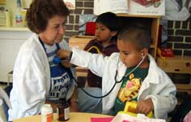
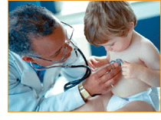
Pre-school Age Assessment
Notes:
Sense of Initiative 3 – 6 yrs.
Positioning of their choice – usually sitting
Keep procedures with instruments until last
Prefer parents close by
Like to dress and undress self; request that they undress self; don’t like to remove underpants
Make up stories about procedures “I’m seeing how strong you are”
Expect cooperation “open your mouth”
Basic Fears = body harm, intrusion, castration

Slide 60
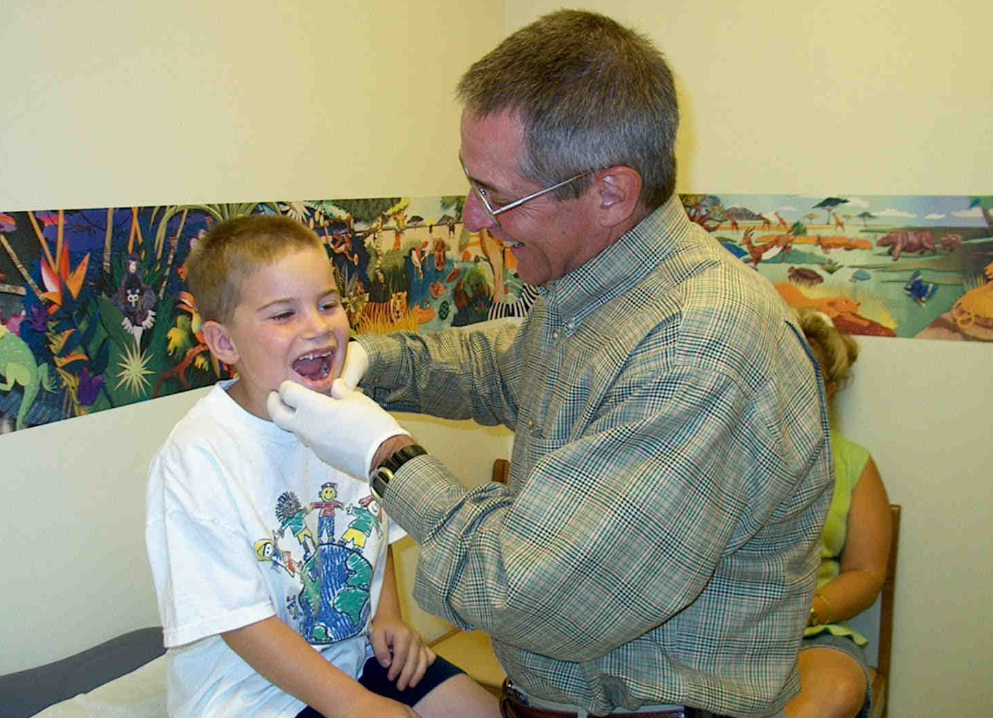
School Age Assessment
Notes:
Industry
Get on their level
Involve them in discussions
Ask them questions not parents
Undress only as necessary
Praise is very important in developing self-esteem
Prefer same sex provider

Slide 61
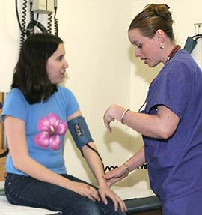
Adolescent Assessment
Introduce self
Ask open-ended questions
(chance to assess cognitive function)
Listen attentively
Do not pretend to understand unfamiliar slang
Variations in maturity between physical growth and cognitive function are broadest in this age group
Explain all interventions (Never touch without explaining what you are going to do)
Remove clothing only as necessary
Notes:
Adolescents may appear angry with life.
Talk to them not parents
Spent time during assessment with parents and adolescent and also with adolescent alone.
With parents to see family dynamics and interaction
With teen alone to get honest answers to sensitive questions

Slide 62
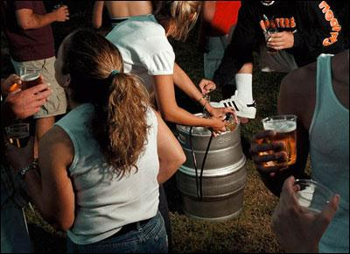
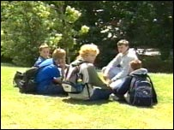
HEADS Interview Instrument
H – Home and Health
E – Education and Employment
A – Activities
D – Drugs and Depression
S – Safety and Sexuality
Notes:
Useful tool for obtaining psychosocial history from an adolescent.
HOME: Questions about home environment, helps to elicit valuable info about safety, support, and relationship issues
EDUCATION & EMPLOYMENT: Questions about scholastic and occupational habits reflect achievement of personal success and motivation. Failure to perform well may suggest need for further assess re. substance abuse or mental health concerns
ACTIVITES: Best friends, relationships, hobbies, leisure activities. Why important? Helps screen for mental health issues and behavioral problems
DRUGS: Always begin with questions about habits of peers and then direct questions. Less threatening.
DEPRESSION: Have you felt down or depressed? When you are down or depressed, what do you do to feel better? Have you ever felt so bad that you thought of hurting yourself? Screening for mood disturbances and coping behaviors provides valuable insight into effects of many physical and psychological changed that occur during adolescence.
SAFETY & SEXUALTIY: Have you ever felt like you were in physical danger? Where do you feel most safe? Do you feel safe at home? has anyone ever touched you in a way that made you feel uncomfortable? 2/3rd of adolescents have had sexual intercourse by time they graduated from high school. Questions about sexuality may uncover health concerns about peer pressure, abuse, sexual encounters, STD’s, and pregnancy.

Slide 63
Pain and Children
Most healthcare professionals underestimate pain in children
Understanding painful response in children and how they differ from adults
Parents best at evaluating pain in their child
Notes:
When assessing you need a specific measurement tool
Always ask child about most painful experience and coping mechanisms used
Ask parent about child’s past experiences with pain (child may not remember)
Olivia and UTI; mentioning ER triggers intense flight/fight response; conscious mind may not remember, but body does
ID word(s) that child uses to express pain
Assess reaction to pain and effectiveness of interventions
Assess precipitating factors, location, onset, duration, quality, intensity, and characteristics of pain
Observe non-verbal cues
Theory of accumulative effects of repeated painful procedures = each procedure intensifies the pain response d/t learned response or changes in nero system?

Slide 64
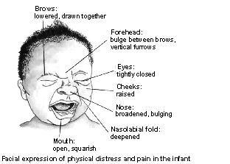
Notes:
Behavioral response is affected by age and dev stage
Observe facial expressions
This is facial response in an infant.
Increased intensity of cry
Increased movement: squirming, jerking, and flailing
Skin may be pale or flushed
Monitor VS for subtle changes = can indicate pain or change in level of pain
Irregular eating and/or sleeping pattern

Slide 65
Pain and Children
QUESTT Assessment:
Question child
Use pain rating scale
Evaluate behavior and physiological changes
Secure parents/caregivers involvement
Take cause of pain into account
Take action and evaluate results
Notes:
Pain rating scale of institution
BEHAVIOR IS KEY!! Decreased activity is abnormal; just sit quietly; may cry when asked about pain;
-altered observations (HR RR BP etc)
–posture/tone
–sleep pattern
–skin color / sweating
When assessing behavior must know normal developmental age of child
Non-pharm = position change
Pharmacologic = pain meds
Assign a consistent caregiver = more at ease with familiar person and caregiver more familiar with child and may notice subtle changes
Involve parents = help to decrease both their and child’s anxiety
Explain all procedures = if kids know what to expect they have less anxiety (Erin with blood work)
Follow home rituals to decrease anxiety (stuffy, music, books)
Age appropriate distraction to decrease pain
Reassure preschool child not to blame self for illness, they are not being punished for being “bad”
Magical thinking = they believe that they did or didn’t do something that caused illness

Slide 66
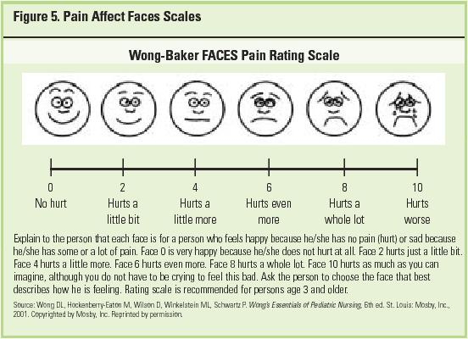
Notes:
Most of you have seen this scale
There are others
Poker chips (each is a piece of hurt/pain; How much hurt do you have?)
Med before all painful procedures, keeping pain under control helps child to cope!
Children will often sleep after pain medication is given. Does not mean they are pain free. They may shut down or withdrawal as way of dealing with pain
Monitor vital signs before and after procedures and meds
Plan to space care around when medicated
Pain med should be based on ratio and proportion for child’s wt. = have second nurse do independent calculations

Slide 67
Medication Administration in Children
6 Rights
Patient
Drug
Dose
Time
Route
Documentation
Notes:
Remember responsibility of giving meds to children is serious
Remember more than ½ of drugs on the market are toxic to children or there is little or no info/research on effects in children
Children are smaller – med dose needs to be adapted to size of child
Children have immature body systems
Meds prescribed in mg/kg/24 hours in many cases
Always ask yourself if the dose makes sense
Only give by route indicated
Patient – check armband (may not be able to tell you)
Drug – know generic and trade names; never assume
Dose – calculate to make sure order is correct; have second nurse independently do calculation. (JCAHO requirement)
Time – Are you giving it at the correct time?
Route – PO, SQ, IM, etc.

Slide 68
Medication Administration in Children
Infant
Use a syringe or dropper
Use natural sucking desire by placing oral medications into a nipple and administering.
Administer before feeding, when hungry
Hold in feeding position
Notes:
Oral meds preferred in kids
Not always possible because of vomiting, malabsorption, refusal, surgery, etc.
Less than 5 yrs of age = liquid med, suspension, chewable
Elevate head and shoulders to prevent aspiration
Oral syringe = midway back to side of mouth
Bib
DO NOT PLACE in juice, H2O, milk may alter and you cannot tell how much was consumed

Slide 69
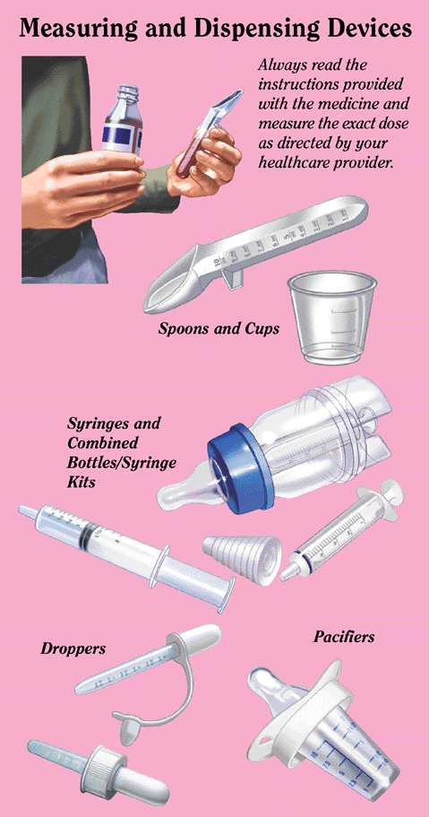

Slide 70
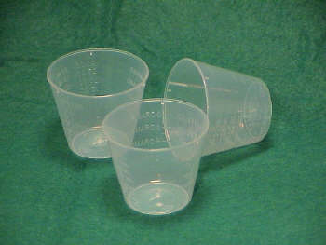
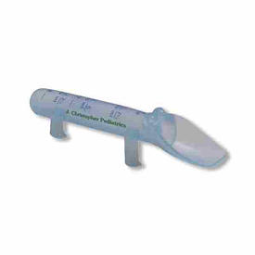
Medication Administration in Children
Toddler
Allow to take from cup or spoon
Disguise in small amount of food
Give simple directions:
“Drink this now”
“Open you mouth”
Notes:
Do not mix in juice; may not drink all of it
Give in small amount of applesauce or pudding
Remember autonomy, negativism
Do not ask “Do you want to take your med now?”
Say “it is time for your med”

Slide 71
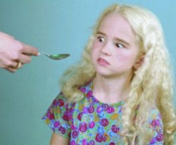
Medication Administration in Children
School-aged
Provide privacy
Fears about body mutilation
Respect need to regress during hospitalization/illness
Involve in meds; Make a poster for times they are due
Reinforce that meds should be taken only from nurse or caregiver
Notes:
Erin with decision for patch of ADD and doxycycline for Lyme’s dx

Slide 72
Medication Administration in Children
Adolescent
Explain why meds are given and how they work
Differentiate medication taking from drug taking
Allow to self medicate
Notes:
Fear losing control, so give them chance to control what they can.

Slide 73
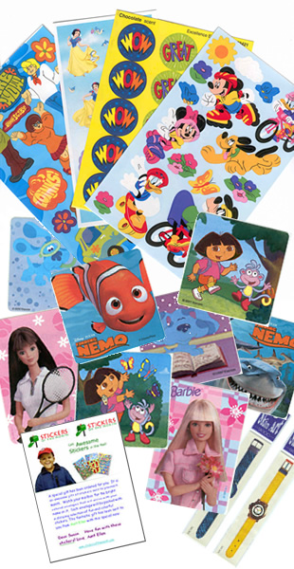
Intramuscular Medications
Given ONLY in treatment room
Band-aid site
Stickers as rewards
Notes:
No IM in child’s room or playroom
Under 3 yrs. Use vastis lateralis (largest muscle) fewer nerves and blood vessels
After 3 use ventrogluteal
Dorsogluteal site is not frequently used in children who have not been walker for 2 yrs.
avoid this site until child is at least 6 yrs.
23 – 25 gauge needle
0,5 to 1 inch long
1 ml max volume
Ped book pg. 365 - 368 shows you sites.
Remember the preschooler’s fear of intrusion; think body is filled with air or fluid and will collapse with puncture like a balloon
Band-Aids are important for this reason

Slide 74
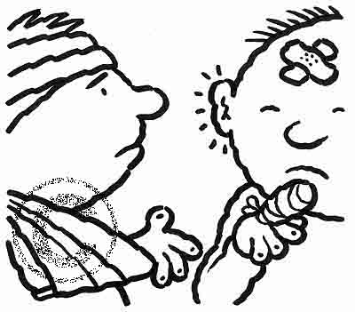
Never underestimate the power of a Band-Aid
Notes:
Most children fear mutilation and like a Band-Aid to cover the area. Toddlers and preschoolers may feel that the Band-Aid will hold them together and/or keep the blood inside.

Slide 75
Ear drops
Infant and toddler pull pinna down and back
Notes:
Why pull down and back? to straighten ear canal

Slide 76
Ear drops
3 yrs. and up pull up and back

Slide 77
Ear Drops
Gently massage area in front of ear
Keep child in position with affected ear up for 5 to 10 minutes after med
Apply cotton plug to prevent leakage
Notes:
Keep cotton in for short time only, need to allow for drainage out of ear

Slide 78
Communicating with children
Relates for child’s age and developmental level
Get on their level
Notes:
To be effective, communication must relate to the child’s age and developmental level.

Slide 79
Communicating with children
Infants
Communicate with crying, body movements, facial expressions, and eye movements
Quickly respond
Say meaningful things
Use sing-sing voice
Face to face
Recognize infant’s unique personality
Notes:
Tell them what is happening, what you are doing, how you are feeling, how you think they are feeling
Take every opportunity to interact with them; bathing, diaper changes, feeding; infants love to watch faces; use facial expressions
Infants are attracted to high pitched sing-song voices (motherese)
Look for cues that infant is ready to interact (eyes open, eye contact) or is over stimulated (looking away, restlessness, fussing)
Even infants have a personality, some are quiet and like to observe without interaction, while others are more active and want more interaction.

Slide 80
Communicating with children
Toddlers
Communicate with simple words, gestures, grunts, and facial expressions
Expand on their one or two word sentences
Respond to their efforts
Label emotions
Give one direction at a time
Warn of transition
Talk through routines
During playtime, follow their lead
Notes:
Understand simple words and commands
Negativism = NO!! They need to say it! Part of developing autonomy
Try to avoid negativism
Never ask child can I, may I or end sentence with OK
Say “It is time to…”
Provide only 2 choices
Choices that you can live with

Slide 81
Communicating with children
Preschoolers
Talk in full sentences
Tell true and imaginary stories
Concrete thinking
Ask open-ended questions; probe for details
Encourage them to talk about feelings
Participate in fantasy play
Allow self talk
Notes:
Begin to recognize connection between spoken word and written word; encourage and support this – read books, label familiar things with written word
May confuse real and imaginary stories
Help them name their feelings and explore the reasons for them
Let them lead the way in play
Self talk helps the child focus on what they are doing and you can learn a lot about what they are hearing, thinking, and feeling

Slide 82
Communicating with children
School-age
Beginning to understand perspective of others
Can tell stories with vivid detail
Ask many questions
More time with peers
Provide reasons for rules and procedures
Encourage them to talk about what is happening in their life and their feelings
Notes:
Ask many questions, as they seek to understand and justify the way things are in their world
Provide reasons for rules and procedures, they want and need to understand

Slide 83
Communicating with children
Adolescent
Egocentric
Trying to understand who they are
Concerned with what others think and feel about them
More negative; more conflict with authority
Be sensitive, responsive, and accepting
Be flexible
Never lie; OK, to say “I don’t know.”
Notes:
Wants to talk about self and their relationships
Need to talk about how they are different from their parents and the rest of the world
Try to understand their perspective before you try to explain yours
Try to be available when they are ready to talk (if on phone, get off)
Allow them the independence and space they need, while providing opportunities for them to express themselves.
Recognize their feelings. Help them to express them the explore the reasons for their behavior
I don’t know” continue with “Let’s find out together” or “Let’s talk about how I can help you find the answer to your question.”

Slide 84
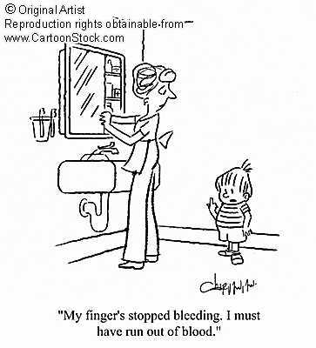
Notes:
Remember with children that words with more than one meaning maybe confusing, think before you speak and choose words carefully.
Lets look at some pictures and you tell me what the nurse said and how the child interpreted it and give me a better way to say it.
“I am going to take blood from you arm now.”
Child thinks you will take it all
Take a specimen – child will not understand word
Blood test – think of test at school
Use stick; BE TRUTHFUL; “This will hurt, for a short while and I will stay with you”
Another reason for a Band-Aid

Slide 85
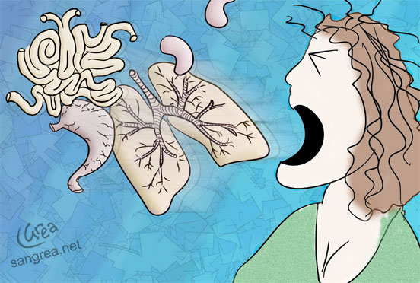
Notes:
Cough up a lung
Wow you are coughing very hard.

Slide 86
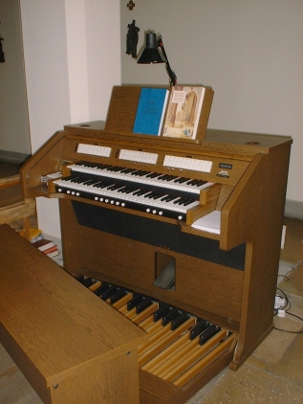
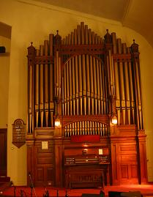
Notes:
Organs?? What?

Slide 87
Notes:
Shot
Some may think they will be shot with a gun
Just a stick

