Slide 1
Alterations in Health During Childhood: Part II
Kimberly Martin, RN,MSN
Nursing Instructor
HACC, Central Pennsylvania’s Community College
Nursing 101; Summer 2012

Slide 2
GASTROINTESTINAL

Slide 3
Cleft Lip and Palate
Congenital Defect
Must provide emotional support to family
Feeding is major problem
Notes:
Cleft = fissure or elongated opening
Cleft lip or palate is one of most common congenital anomalies of newborn
Any type of cleft interferes with normal anatomic structure of lip, nose, and muscles of palate
Degree of malformation depends on type, placement and severity of cleft
Family history = genetics
Environmental causes = parental causes (age, alcohol ingestion, drugs like Dilantin and valium, diet deficient in folic acid)
Some cases see only on manifestation however most = BOTH
Genetic or environmental cause
Should be intact by 10th week of gestation
Incidence 1:1000 cleft lip and 1:25,000 cleft palate
50% of time cleft lip accompanies cleft palate

Slide 5
Cleft Lip and Palate
Must provide emotional support to family
Reaction to cleft lip much greater than to palate
Nurses need to be positive
“Baby is beautiful, full head of hair and beautiful eyes, does have a very common problem with his/her lip that will need to be repaired”
You do not want parents to reject child
Control your response
Notes:
Diagnosis most often made at birth
Delivery room atmosphere changes immediately
Assess caregivers reaction
Initially shock, grief, isolation, failure/inadequacy
Shock is followed by anger, guilt, frustration, and depression

Slide 6
Cleft Lip and Palate
Feeding is major issue prior to surgery
Time consuming and frustrating
Longer nipple with enlarged holes
Breast feeding can be attempted
Notes:
Need to assess ability to suck, swallow, and feed
Nipples are cross cut so easier flow
Encourage Breastfeeding, but may be impossible

Slide 7
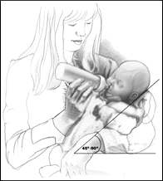
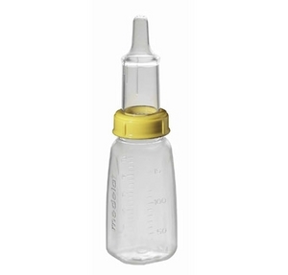
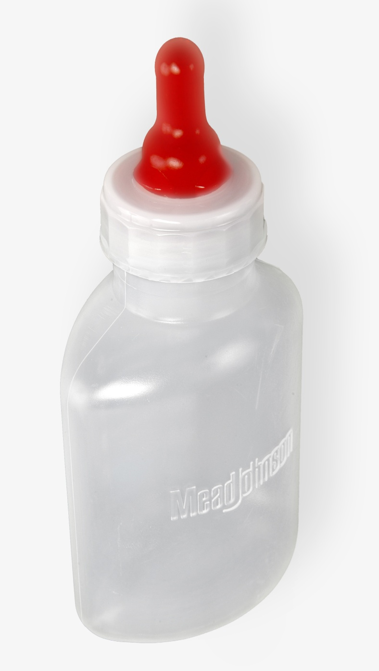
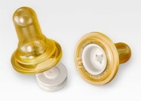
Various nipples and equipment are
used to drip formula/breast milk
toward back of mouth away
from opening
Notes:
You want to show parents/caregivers before and after pictures
May be preoccupied with appearance
Experiencing negative feelings toward infant can disrupt and/or impede attachment
Recognize reaction as normal and encourage them to hold, touch, and feed infant
Give them chance to talk; answer questions
Cleft lip/palate foundation is great source of info and support

Slide 8
Cleft Lip and Palate
Feeding
Expect lots of coughing and sputtering
Hold upright
Frequent burping
Formula/breast milk may seep up and out nose
Do not overly tire, frequent rest periods
Place on right side after feeding to prevent aspiration
Good mouth care, rinse with water after feeding
Notes:
Demonstrate with baby

Slide 9
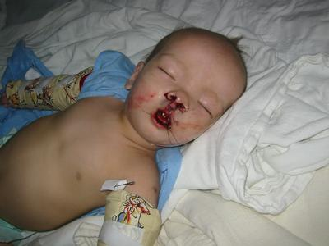
Cleft Lip and Palate
Post-op Repair of Cleft Palate
Nothing in mouth
Elevate HOB to ease breathing
Need to change from mouth breather to nose breather after surgery
Notes:
Repair of lip may be done immediately or at 2 months of age or weight > 10 pounds
Repair of palate done between 6 and 12 months
Nothing in mouth; DO NOT want to damage suture line and cause scaring

Slide 10
Cleft Lip and Palate
Post-op Repair of Cleft Lip
Protect suture line
Keep suture line clean
Place on back or side
Use mobiles or music to stimulate
May use restraints to prevent touching mouth
Notes:
Protecting suture line is most important part of care
Keep suture line clean; wash with sterile NSS or water
Clean well after feedings
CRUSTING = SCARRING

Slide 11
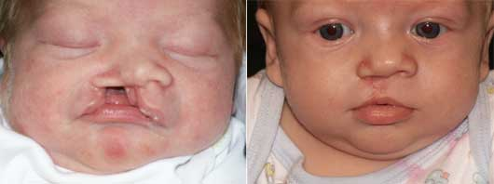
Cleft Lip and Palate
Notes:
Treatment is complex and involves many specialists
plastic surgeon
neurosurgeon
orthodontist
otolaryngologist
pediatrician
nurse
speech pathologist
audiologist

Slide 12
Cleft Lip and Palate
Long-term consequences
Speech difficulties
Malocclusion
Recurrent Otis Media
Will need follow-up with dentist and orthodontist
Notes:
abnormal teeth eruption even after repair)

Slide 13
Congenital Esophageal Atresia and Tracheoesophageal Fistula
Rare malformations of esophagus and trachea
May occur separately or in combination
Pose a serious threat to infant’s well-being
History of maternal polyhydramnios is common
Notes:
Polyhydramnios- associated with congenital anomALIES THAT INTERFER WITH SWOLLOWING (amniotic fluid is normally swollowed bythe fetus is unablre to reach the GI tract to be absorbed and excreted by the kidneys.
Esophagus fails to form to the stomach; usually ends in a pouch
86% OF CASES IS ONE WHICH THE PROXIMAL ESOPHAGEAL SEGMENT TERMINATES IN A BLIND POUCH AND THE DISTAL END IS CONNECTEED TO THE TRACHEA OR PRIMARY BRONCHUS BY A SHORT FISTULA ( abnormal tube like passage from a normal cavity or tube to a free surface or another cavity ) AT THE TRACHEAL BIFURCATION
Distal segment of esophagus may connect to trachea via a fistula
Aspiration is main threat; also malnutrition

Slide 14
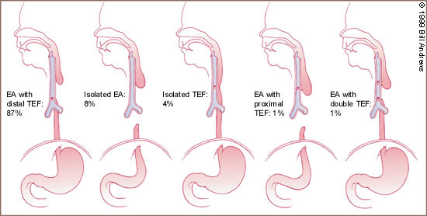
EA with TEF
Notes:
Discuss each type
Fistula may be distal or pro
Consists of a blind esophageal pouch with a fistula between the trachea andthe distal esophagus,which is estimatedto occur 84 percent of the time .The fistula often entersthe trachea close to the carina.
second most common anomaly is pure atresia without tracheoesophageal fistula. This condition is usually associated with an underdeveloped distal esophageal remnant, making surgical repair more cumbersome.
Third most common variationi s the H-type fistula, which consists of a tracheoesophageal fistula without esophageal atresia. This aberration is more difficult to diagnose clinically. If the fistula is long and oblique, the symptoms may be minimal ,and the condition may not be identified for many years.

Slide 15
EA with TEF
Signs and Symptoms
Excessive frothy saliva and drooling
Coughing and choking during feedings
Cyanosis with feedings
Regurgitation of feedings
Diagnosis
Attempt to pass NG tube into stomach
X-rays to establish exact type
Notes:
3 C’c = choking, coughing, and cyanosis especially following or during feedings.
A radiopaque cathertar is inserted into the hysopharynx and advanced until it encounters obstruction. CXR are taken to ascertain esophogeal patency otf the presence and level of the blind pouch

Slide 16
EA with TEF
Care/Treatment
NPO with IV fluids
oral and NG suctioning as needed
HOB up 30 degrees
PEG feedings
Provide pacifier
Promote maternal/infant bonding
Corrective surgery
Notes:
Primary goal is to prevent aspiration and aspiration pneumonia. Remove secretions that can be a source of aspration (suctioning
May require PEG tube feedings until surgery is done and healed.
Pacifier to satisfy sucking needs, especially during feedings without oral stimulation child can develop feeding resistance (oral sensativity or feeding aversions) complete team for feeding specialist and behavior may have to be consulted.

Slide 17
Hypertrophic Pyloric Stenosis
Hypertrophy of pyloric muscle and narrowing of pylorus
Projectile vomiting, weight loss and dehydration
Treatment = Surgery
Pre-op
May thicken feeding
IV fluids and NPO
Post-op
Feed slowly with frequent burps
Progress feedings slowly; monitor tolerance
Position on right side to prevent aspiration
Strict I & O with number and type of stools
Notes:
Pylorus = distal end of stomach
Partial or complete obstruction occurs
Symptoms appear at 2 – 4 wks of age
As baby eats more symptoms start
Vomitus with sour smell, appears like curdled milk and mucous
Vomit never bile colored WHY?
bile only present in small intestines and bile cannot enter stomach because of obstruction from stenosis
Vomiting = MOST OUTSTANDING SYMPTOM
May occur with each feeding or intermittently
Will want to re-feed = constantly hungry and irritable
Dehydration? Sunken fonts, inelastic skin, decreased UO and elevated urine sp. Gravity
How do we get accurate I&O on infant? Weigh diapers 1ml = 1oz of urine
Preop improve and maintain hydration

Slide 18
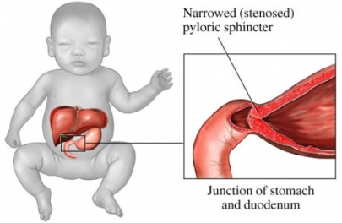
Notes:
May palpate olive-sized tumor at end of stomach

Slide 19
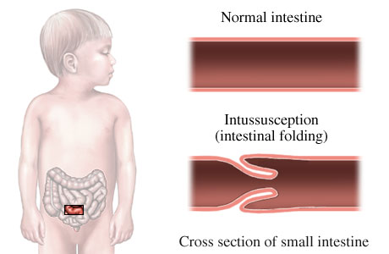
Intussusception
Telescoping of one portion of bowel into another
Sudden onset of colicky abdominal pain, fever, vomiting, and currant jelly stools
Barium enema to diagnosis and treat
Bowel resection, if barium enema unsuccessful
Notes:
See mostly in males 3 -12 months
Most common site is ileocecal valve
Portion may burst and cause peritonitis
Most frequent cause of intestinal obstruction in infants and children
Sudden abd. Pain = child screams and draws up legs; may appear comfortable between pain episodes
Vomiting bile, then stool
“currant jelly stools” = stools with blood & mucus
Child will become listless and lethargic
Ba enema is definitive test
On exam you may feel sausage shaped mass
Involved part of intestinal walls press against each other and compromise blood and lymph flow
If untreated necrosis, perforation, and death.

Slide 20
Congenital Aganglionic Megacolon (Hirschsprung’s Disease)
Congenital lack of nerve cells in wall of colon
No peristaltic action in that portion
Portion above it becomes dilated; filled with feces and gas
Signs and Symptoms:
Constipation
Distended abdomen
Bile-stained mucus and emesis
Anorexia
Notes:
Failure to pass meconium stool in newborn
May refuse to eat
May have foul-smelling ribbon-like stool or pellet-like
Will not have adequate weight gain

Slide 21
Congenital Aganglionic Megacolon (Hirschsprung’s Disease)
Diagnosis;
Symptoms
Barium Enema
Care:
NPO with IV fluids and NG suction
Treatment:
Bowel resection with or without colostomy
Notes:
Need biopsy for definitive diagnosis
Surgery as early as possible
Care NPO, IV, NG, family support and education

Slide 22
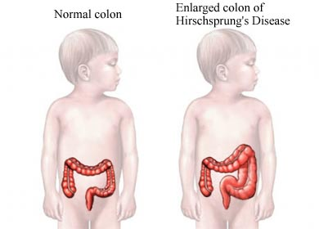
Notes:
Nursing care
Pre-op = assess F&E balance, NPO, IV fluids
Post-op = routine post-op abdominal surgery interventions
1. maintain patency of NG
2. monitor abd
3 monitor and record colostomy appearance and output
4. maintain nutrition
5. Teach parents ostomy care
6. No Rectal Temps post-op

Slide 23
Imperforate Anus
Rectum ends in blind pouch above anus
No anal opening
Signs and Symptoms
No stool in first 24 hours
Abdominal distention
Absence of anus
Diagnosis = digital exam and/or X-rays
Surgery, if needed
Notes:
Congenital defect
occurs 1 in 5000 births
May have thin membrane covering anal opening that can be perforated easily.
NO RECTAL TEMPS
Will require Parenteral nutrition until surgery. Monitor I&O and nutritional status.
May have NG before surgery and after surgery until bowel function returns to prevent distention.
May require temporary colostomy; may have problems with sphincter control and toilet training.

Slide 24
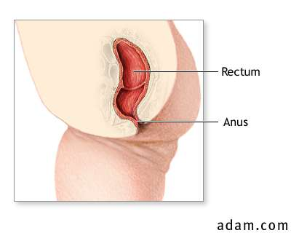
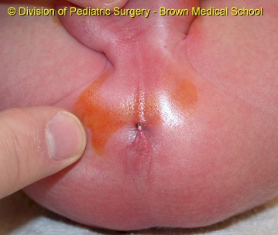
Notes:
May have dimple, but no opening

Slide 25
Idiopathic Celiac Disease (Gluten-Induced Enteropathy)
Malabsorption disease characterized by hypersensitivity to gluten
Leads to impaired fat absorption
Theory = inborn error of metabolism with allergic reaction to gluten
Notes:
Child inherits inability to effectively digest gluten. 2nd only to cystic fibrosis as a cause of mal absorption in children. Found in wheat, barley, rye, and oat grains
Undigested gluten causes inflammation and damage to small intestinal lining leading to malabsorption. Lead to villous atrophy thus mal absorption due to decreased surface area
This can occur at any age
stressors that can trigger active dx
gluten overload
pregnancy
GI virus
surgery
stress

Slide 26
Celiac Disease: Classic Childhood S&S
Appears after introduction of gluten
Steatorrhea = foul smelling bulky, fatty stools
Anemia
Malnutrition and hypocalcemia
Fretful, crying
Frequent respiratory infections
Vomiting
Growth retardation
Notes:
Classic S&S as seen in children
Usually appears several months after child starts eating wheat (1-5 years)
Because no wheat or rye in diet before this age
Diarrhea; often pale and watery with odor
Second only to CF as cause of malabsorption in children
See muscle wasting
Sometimes vomiting and constipation
If S&S continues see growth retardation
Seen frequently in association with type I DM

Slide 27
Celiac Disease: Diagnosis
Try gluten free diet and evaluate results
Serum screening of IgG and IgA antigliadin antibodies
Biopsy of jejunum shows changes in villi
Notes:
All symptoms resolve when gluten is removed from diet
IgG and IgA are present while eating gluten and disappear when gluten is removed from diet
Dx antigliadin and antiendomysial immunoglobulin G IgG and IgA anti bodies and their diapperance when gluten is removed from the diet

Slide 28
Celiac Disease: Treatment
Dietary Program: no wheat, barley, rye, or oat products
Vitamin and mineral supplements
Must teach parents to read labels
Many commercially canned soups, cold cuts, hot dogs, pudding mixes, breads, cakes, and pastries have these
May use potato, corn, or soy flour
Notes:
Gluten-free diet for life
NO BEER OR ALE (what are they made from? Oats and wheat!!!)
Reading labels is a must.
Many products use gluten as a stabilizer, especially in thickened things like pudding and soup.
Next time you go grocery shopping look at some labels and see what has wheat, rye, or oat flour

Slide 29
Celiac Disease: Across the Lifespan
Manifestations vary
Symptoms may appear at any time
Unexplained iron-deficiency anemia
Malnutrition
Associated autoimmune disorders
Notes:
Malnutrition may be responsible for seemingly unrelated conditions, such as; depression, inability to concentrate, anxiety, insomnia, HTN, coagulopathies, obesity, anorexia
Associated autoimmune disorders, such as; type I DM, hypothyroidism, several types of lymphoma
Difficult to diagnosis
The longer the body is exposed to gluten the more damage that will be done
Anyone with any of these sign should have antibody studies done and maybe small bowel biopsy

Slide 30
Infectious Diarrhea
Caused by variety of pathogens
Bacteria
Virus
Frequent loose, watery, green stools
Isolate
Broad spectrum antibiotics, IV’s and NPO
Notes:
Very dangerous!! Can dehydrate rapidly
Highly contagious
Can be fatal
Isolate (Contact with feces or vomitus) and use GOOD HAND WASHING to prevent spread; TRY TO KEEP CHILD’S HANDS OUT; WASH CHILD’S HANDS TOO AFTER DIAPER CHANGE
NO CLOTH DIAPERS WHY? When high absorbency paper diapers were used, contamination was significantly lower than when cloth diapers were used. The problems of solid waste management and closing landfills willnot go away, and approximately two percent of the garbage by weightis paper diapers.Many states are looking into banning disposable diapers in day-care centers, but the gains in waste management mustbe weighed against greater contamination and the spread of infectious diseases among small children.The use of paper diapers and overclothesis thebest way to minimize fecal contamination and reduce the incidence of intestinal infections among infants and children attending day-care. (Consumer Summary produced by Reliance Medical Information, Inc.) Watery stools – expelled with force
May vomit
S&S dehydration = sunken eyes and fontanels; Dry skin, tongue and mucous membranes
TX bolus, 20ml/kg, stool cultures, give gut a rest and hydrate

Slide 31
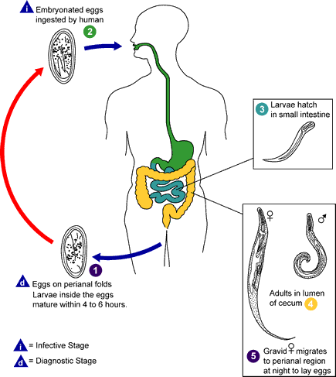
Pinworm
White thread-like worms invade cecum
Spread person to person
Eggs are swallowed and mature in cecum
Female crawls out of anus at night and lays eggs on perineum
Scratching often leads to reinfestation
Notes:
Spread person to person through contaminated articles
Severe itching around anus
Eggs under fingernails and they eat and swallow new eggs

Slide 32
Pinworm
Treatment
Capture eggs from around anus with cellophane tape
mebendazole (Vermox)
Hand washing
Keep finger nails short
All family members should be treated simultaneously
Notes:
Tape on tongue blade

Slide 33
GENITOURINARY

Slide 34
Hypospadias & Epispadias
Urethra on underside of penis
Urethra on top side of penis
Surgery done for either condition
Use foreskin (NO CIRCUMCISION)
May requires several surgeries
Done at 6 – 12 months of age
Notes:
Hypospadias: meatus on ventral side of penis
occurs in 8.2 per 1000 live births
Caucasians have highest incidence
Hispanics have lowest
genetic predisposition = family history
some boys = defects in testosterone metabolism or receptors
failure of fusion during fetal development
Epispadius: meatus on dorsal side of penis
Surgery: number of surgeries is related to severity of malformation; can do most in one surgery now; foreskin is used; may have foley after
Surgery done prior to toilet training and development of body image to decrease psychological stress

Slide 35
Hypospadias
Notes:
Goals of surgery
able to void in standing position
cosmetically normal appearing penis
preserve sexual function
In severe cases it may be difficult to tell a boy from a girl with a glance

Slide 36
Cryptorchidism
Undescended testes
May descend on own in 1 year
Incidence: 33% in preterm and 3 – 4% in full term infant
Notes:
Failure of one or both testes to descend through the inguinal canal into the scrotum
Clinical manifestation = NO BEANS IN THE BAG; rarely painful
Treatment = observation for one year
Surgery between 1 – 2 yrs of age (usually by 3 years of age)
Goal is to bring testes into scrotal sac and secure by scrotal fixation

Slide 37
Wilms Tumor (Nephroblastoma)
Malignancy arising from embryonic tissue remaining after birth
Affects one or both kidneys
Prognosis best for child < 2 yrs.
During early stage of growth; no symptoms
Can become quite large
Starts in renal capsule
Remains encapsulated for long time
Notes:
Most common malignancy in early life
Usually develops before age 3 yrs.
Slightly higher in males

Slide 38
Wilms Tumor (Nephroblastoma)
Treatment:
Immediate surgical removal of kidney and ureter
Follow-up chemo and/or radiation
Pre-op: DO NOT PALPATE ABDOMEN
Place sign over bed with these instructions
Post-op
Support family
Educate family
Notes:
No S&S
Usually found by parents while bathing or dressing child
Swelling or mass within the abdomen
non firm, non tender, confined to one side and deep within the flank
May be found on routine exam
Diagnosed with CT, MRI, US
Need to ensure that other kidney is functioning
Need surgery within 24 to 48 hrs.
DO NOT PALPATE ABD. WHY? May increase risk of tumor rupture and spreading of cancer cells in abd.
Survival rate is one of the highest among all childhood cancers. Surgery and chemotherapy based on clinical stage
May not be able to pla sports or other high risk activities
Watch for tight waistband or other manipulation

Slide 39
Acute Glomerulonephritis
Autoimmune reaction to group A Βeta hemolytic strep infection
Antigen-antibody reaction causes inflammatory response that blocks glomeruli
Retention of water and sodium
RBC’s and protein escape into urine
Notes:
Body reacts to protein found inside strep bacteria Release of membrane like material from the organism into the circulation. Because it is antigenic, antibodies are formed. The immune complex reaction ocurs and becomes trapped in the glomerular capillary loop
Body attacks own collagen structures
Nephron is working part of kidney
Within nephron are clusters of capillaries called glomeruli
When glomeruli are inflamed and blocked RBC’s and protein escape into urine

Slide 40
Acute Glomerulonephritis Signs and Symptoms
Grossly bloody urine
Mild to moderate HTN
Periorbital edema
Fever
H/A
Malaise and anorexia
Proteinuria
Mild to moderate hypertension
Decrease urine output
Notes:
Begin 1 – 3 wks after strep infection/lasts 2 – 3 wks
Prognosis excellent
Appear very ill
Small # of children will go on to develop chronic glomerulonephritis
Peak age = 6 – 7 yrs. (occurs btw. 5 – 10 yrs)
2 X more males
See decreased urine output
Urine tea colored and opaque; parents may say cola looking
Macroscopic hematuria ( large enough to be seen by the naked eye)

Slide 41
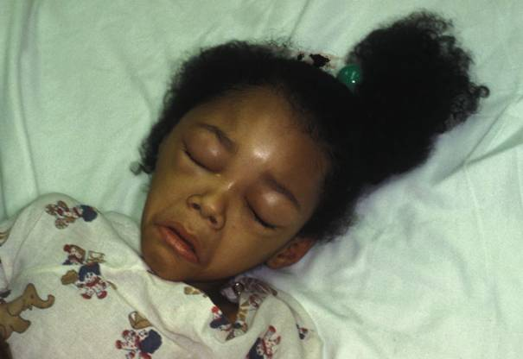
Acute Glomerulonephritis
Notes:
Periorbital edema

Slide 42
Acute Glomerulonephritis Diagnostic Studies
Urine:
RBC’s
WBC's
+ Protein and Albumin
Elevated Specific Gravity
Blood
Streptococcal antibodies
Elevated BUN and CR
Elevated Sedimentation rate
Notes:
No bacteria seen in urine
See increased sed rate with antigen/antibody reaction

Slide 43
Acute Glomerulonephritis Nursing Interventions
Restrict activity during acute phase
Sodium restricted diet
Potassium restricted diet during periods of decreased urinary output
Antibiotics
Antihypertensives
Notes:
Monitor VS (BP)
Monitor Breath sounds (Crackles)
I&O
Daily Weight
Specific Gravity
Check urine for protein and RBC’s
Antihypertensives
Diuretics
PCN to eradicate strep
NAS diet
Treat symptoms of HF (if occur)
Teach family to check urine for protein
Mild cases treated at home; more severe may require hospitalization
Limit activity/no bedrest; child will probably voluntarily restrict their activity d/t fatigue
Wt to evaluate fluid volume
Lungs to evaluate for HF d/t fluid overload
May have fluid and Na restriction
Antihypertensives are used for elevated BP; this is major complication; highly elevated BP can cause increased ICP, seizures, and brain damage
Diuretics like Lasix may help in mild cases
May have traces of protein in urine for months; family will need to know hoe to test urine for protein
Child will require frequent follow-up until urine is clear of blood and protein (Months)
If Proteinuria, lasts longer than 1 yr. = diagnosis of chronic glomerulonephritis
See chart in book on pg 261

Slide 44
Nephrotic Syndrome (Nephrosis)
Also known as:
Lipoid Nephrosis
Idiopathic Nephrosis
Minimal Change Nephrotic Syndrome (MCNS)
Notes:
Damage to capillaries of glomerulus
Chronic renal disease
Principle pathophysiologic abnormality = increase permeability of glomerulus to protein = massive protein lost
MCNS is most common term used

Slide 45
Nephrotic Syndrome
Disease of remissions and exacerbations
Cause in not known
Maybe hypersensitivity reaction
Occurs between age 2 – 7 yrs.
Notes:
Disease usually resolves itself after time
Peak age 2 – 3 yrs.

Slide 46
Nephrotic Syndrome Signs & Symptoms
Weight gain
Edema
Periorbital
Abd. swelling
Anorexia
Easily fatigued
Malnutrition
More susceptible to infection
Urine
Decreased amount
Dark and frothy
Diarrhea
Decreased or normal BP
Notes:
Edema progresses slowly = Periorbital seen in am and resolves with upright activity
ankle seen later in day
advances to generalized edema with large abd. ascites
edema in scrotum and labia
unable to button pants
Malnutrition d/t loss of protein
Anorexia d/t intestinal mucosal edema, uncomfortable, may go unnoticed because of chubby appearance
Resp distress d/t pressure from fluid in abd.

Slide 47
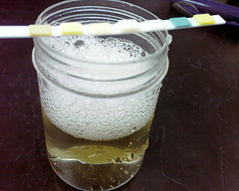
Nephrotic Syndrome Diagnosis
Proteinuria
Low serum total protein and albumin
Hyperlipidemia
NO GROSS HEMATURIA
Notes:
If loosing protein in urine = lower protein in blood
Serum albumin will be severely low (below 2 g/dL)
Hyperlipidemia = elevated cholesterol and triglycerides (not sure why this happens)
No gross hematuria

Slide 48
Nephrotic Syndrome Treatment
Corticosteroid therapy
Prednisone
Diuretics
Diet
Sodium restriction during edematous stage
Fluid restriction with severe edema
Small frequent meals
Immunosuppressant therapy
Cytoxan
Notes:
Prednisone capable of inducing remission with kids with idiopathic cause (starts to decrease protein loss in 7 – 21 days)
Prednisone given for at least 6 wks, then gradually decreased over next 6 wks (total of 3 months therapy gets best results)
Diuretics = only with respiratory involvement = not effective for this edema; WHY?; Need protein to decrease edema
Limit high salt foods during edema period (chips, pretzels, processed meats, fast foods)
High protein diet usually has not effect (loosing as fast as eating); may cause further kidney damage
Immunosuppressant therapy will reduce or eliminate relapse for some children, but has significant side effects (leukopenia, sterility in males)

Slide 49
Nephrotic Syndrome Nursing Care
I&O
Daily weight
Abd. girth
VS
Breath sounds
Peripheral edema
Urine dipstick for protein
Inspect skin for breakdown
Monitor calorie intake
High protein diet
Prevent infection
Parent teaching for home care
Notes:
Watch fluid balance
Watch resp status
Monitor Proteinuria
Skin fragile while edematous watch for skin breakdown
May be on bedrest or at least limited activity
Parent teaching =
steroid therapy = continue as ordered; do not stop abruptly
check urine for protein
diet restrictions
signs of relapses
preventing infections
Remember 2 – 6 yr old may see bedrest as punishment and may see regression
Age appropriate divers ional activities

Slide 50
Comparison of Disorders
Acute Glom. Nephritis
Autoimmune rxn.
5 – 10 yrs peak
#1 symptoms = HEMATURIA/HTN
Periorbital edema
Mild edema
Oliguria
Acute; lasts 2 – 3 wks
Nephrotic Syndrome
Hypersensitivity rxn ?
2 - 3 yrs peak
#1 symptom = EDEMA
Generalized edema
Respiratory distress
Anorexia & malnutrition
Chronic with relapses

Slide 51
HEMATOPOIETIC

Slide 52
Leukemia
Cancer of blood-forming tissues (bone marrow)
Increased production of immature WBC’s prevents development of normal ones
Cause is unknown
Notes:
WBC = lymphocytes

Slide 53
Leukemia
Immature lymphocyte = lymphoblast
Lymphocytes reproduce so quickly that they are mostly in blast or immature stage
Causing crowding and malfunction in bone marrow

Slide 54
Leukemia Causes a Decrease in:
Normal WBC’s
RBC’s
Platelets
Notes:
WBC’s B/C of increased # of immature cells = increased risk of infection
RBC’s B/C of crowding in bone marrow = anemia
Platelets B/C of crowding in bone marrow = bleeding without clotting
RESULTS IN THE S&S YOU SEE

Slide 55
Leukemia: Symptoms
Fatigue and irritability
Pallor
Susceptibility to infection
Easy bruising and bleeding
Bone and joint pain
Pathological fracture
Headache
Liver/Spleen/Lymph nodes enlarged
Nausea/vomiting/anorexia/weight loss
Notes:
Fatigue = anemia
Infection risk = low WBC
Bleeding = low platelet
Bone and joint pain = proliferation and invasion of immature cells
Fractures = crowded bone marrow more fragile
Enlargement = proliferation and invasion of immature cells

Slide 56
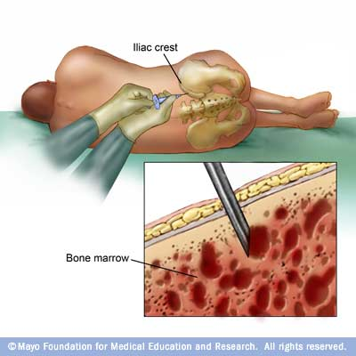
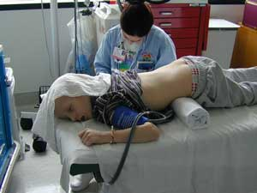
Leukemia: Diagnostic Tests
CBC with differential
Bone marrow aspiration
Notes:
CBC may show lymphoblasts immature wbc
Bone marrow aspiration confirms diagnosis
Use iliac crests

Slide 57
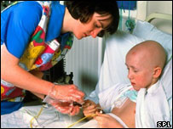
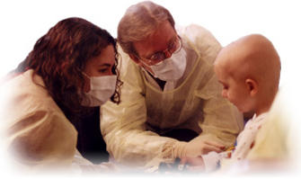
Leukemia: Treatment
Intensive Chemotherapy
Bone marrow transplant with immunotherapy
Notes:
With initial diagnosis prognosis is good – 90% survival rate
With relapse survival rate drops dramatically
Chemo in 3 phases
INDUCTION = geared toward a complete remission with no leukemia cells remaining
Sanctuary prevents invasion of CNS by leukemia cells. Intrathecal administration of methotrexate or other chemotherapeutic drugs into cerebrospinal fluid via LP
MAINTENANCE = maintaining remission for 2 -3 yrs, includes follow-up chemo, these kids have access device: Boviac, CVP, mediport, Hickman
If re-occurs or relapses = reinduction with drugs used before plus additional drugs
Bone marrow transplant if 2nd remission with all children with ALL

Slide 58
Leukemia: Nursing Care
Prevent Infection
Hand washing
Reverse isolation (protective)
Private room
No visitors with illness
No fresh fruits or flowers
Monitor VS
No rectal temp
Protective environment
Minimize falls, injury, bleeding
Notes:
Hand washing is essential
Reverse protective isolation to prevent deadliest complications; meningitis, encephalitis, pneumonia (most frequent causes of death)
Protective isolation B/C of compromised immune system – especially during induction
VS monitor temp for any variations

Slide 59
Leukemia: Nursing Care
Nutritional support
Prevent skin breakdown
Promote positive body image
Alopecia
Clean to prevent cradle cap
Provide emotional support to child and family
Hospice care
Notes:
Extra special nutritional needs – may be difficult due to N/V with chemo
Small frequent caloric dense feedings
Encourage favorite foods
Fluids by dropping from straw if unable to suck
Be creative
Keep meals pleasant, no invasive procedures and no interruptions
Alopecia – grows back in 3 – 6 months
Cradle cap – good scalp care needed to prevent accumulation of oil and dirt
Fear of death – allow/encourgae child and family to express fears and concerns
Care of parents and siblings – need supportive care; sibs can feel guilt, resentment, and fear

Slide 60
Hodgkin’s Disease
Highest incidence in adolescence and young adulthood
Malignance of lymph system
Primarily involves lymph nodes
May metastasize to spleen, liver, bone marrow, or lungs
Early diagnosis (Stage I) with radiation treatment is curative 90 -100%
Notes:
Effects males twice as often as females

Slide 61
Hodgkin’s Disease: Signs and Symptoms
Painless enlargement of lymph node:
Neck
Axillary
Inguinal area
If left untreated, lymph nodes will enlarge and lymph tissue will invade mediastium and retroperitoneal cavity
Notes:
Neck (cervical) nodes are most common

Slide 62
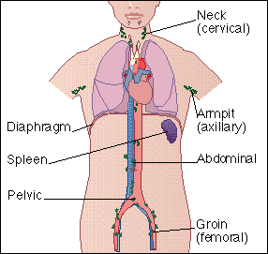
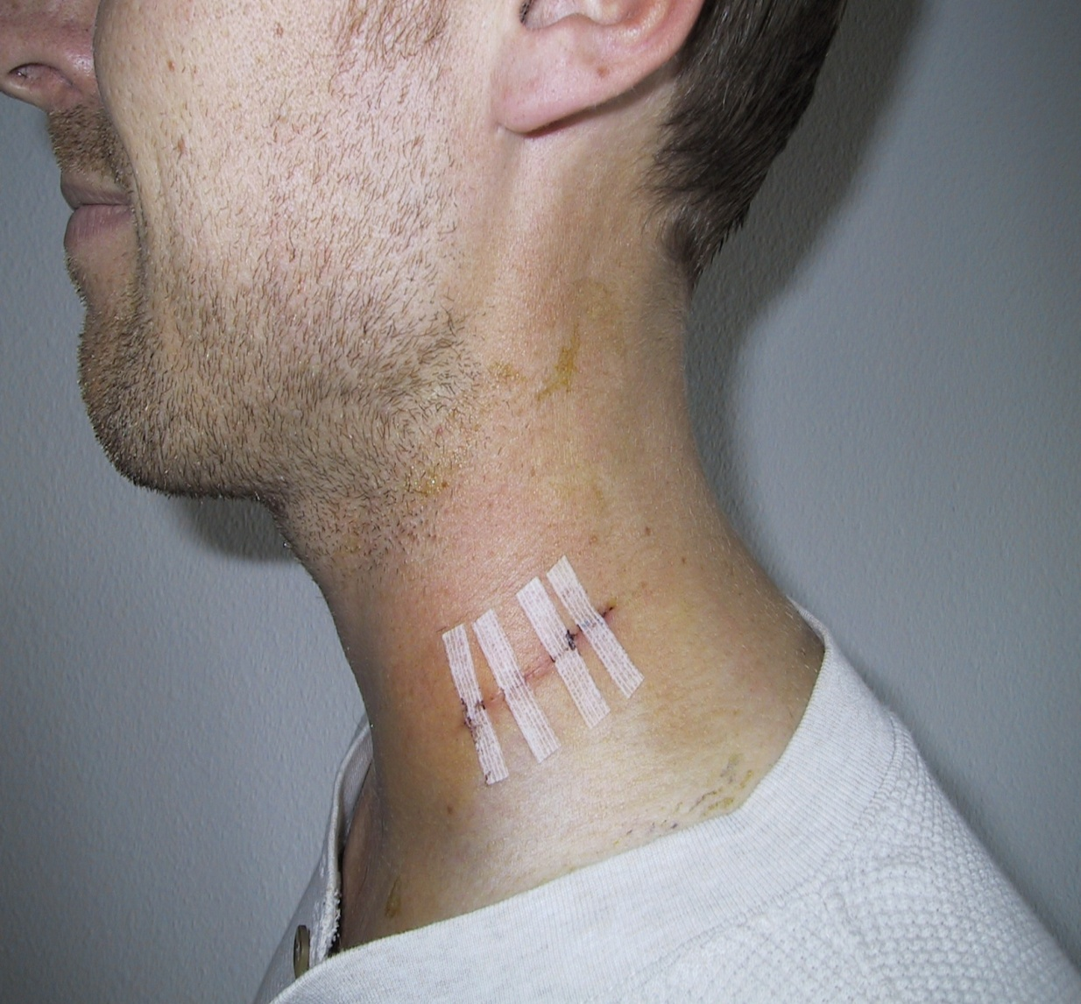
Hodgkin’s Disease
Notes:
Lymph nodes in body
After surgical removal of cervical lymph node

Slide 63
Hodgkin’s Disease: Signs and Symptoms
More advanced cases
Fever
Anorexia
Weight loss
Fatigue
Rash
Prone to infection

Slide 64
Hodgkin’s Disease: Diagnosis
Rule out other reasons for enlargement
CBC
Abnormal diff
Chest X-ray
Mediastinal mass ?
Lymph node biopsy
Reed-Sternberg cells = large atypical cells
If positive: MRI for metastasis

Slide 65
Hodgkin’s Disease: Staging
Stage I = single lymph node, no symptoms
Stage II = 2 or more lymph nodes on same side of diaphragm
Stage III = lymph node involvement on both sides of diaphragm
Stage IV = diffuse disease on both sides of diaphragm and multiple organs involved
Notes:
Done by laparotomy
Spleen usually removed
Stage IV usually spleen is involved

Slide 66
Hodgkin’s Disease: Treatment
Stage I and II = radiation therapy
Stage III and IV = radiation and chemotherapy

Slide 67
Hodgkin’s Disease: Nursing Care
Control or minimize side-effects of radiation and/or chemo
Prevent infection
Hand washing
Avoid contact with infectious/ill people
Control pain and nausea
Medication
Relaxation techniques
Notes:
More susceptible to infection after spleen removal

Slide 68
Hodgkin’s Disease: Nursing care
Fatigue/Malaise
Frequent rest
Less physically demanding areas of interest
Pace activities
Fear
Support groups
Explain all procedures
Allow to vent feeling and concerns
Body Image Changes
Ventilate feelings
Use of wigs/scarves/hats
Notes:
Remember these are teenager and young adults, so peers are very important .
ID and self image are also extremely important to them

Slide 69
Hemophilia
One of oldest hereditary diseases
Sex-linked recessive trait
Found in primarily males and transmitted by females
Hemophilia A: most common and severe form
Deficiency of factor VIII
Hemophilia B:
Deficiency of factor IX
Notes:
1 in every 10,000 persons
Sex linked
Deficiency of factor 8
Severity depends on amount of factor 8 in blood
Hemophilia B = Christmas disease

Slide 70
Hemophilia: Signs & Symptoms
Elevated PTT
Hemorrhage
Excessive bruising
Complications
Brain hemorrhage
Crippling joint disability
Notes:
Prolonged bleeding time
Bleeding into skin, joint spaces, and intramuscular tissue
Joint spaces similar to leukemia

Slide 71
Hemophilia: Treatment
Factor VIII concentrates
Given slow IV injection or infusion
Replaces missing clotting factors
Done as needed for bleeding episode
Dose is dependent on weight, severity of bleed and coag. studies
Apply prolonged pressure to venipuncture and injection sites
Notes:
Concentrates can come from donors or produced by genetic engineering
From donors has risk of HIV and Hep B infection; has gotten better, but still possible
Ryan White – given concentrates tainted with HIV in 1980’s; caused his and many other deaths
Prognosis is now good
In Europe give antihemophilic factors prophylaxically to prevent bleeding; not used in US much at this time

Slide 72
Hemophilia: Nursing Care
Assess for bleeding
Administer clotting factors
Relieve pain
Prevent injury
Control bleeding
Prevent crippling effects
Teaching
Notes:
Check gums, examine joints, for tenderness and swelling
Check skin for bruising
Hematuria
Headache
Black tarry stools
Pain – especially joints (hemarthosis – need narcotics, immobilize joint, elevate, careful handling, cold packs, administer antihemophilic factors immediately)
Teaching = most care done at home; parents learn how to give med IV for 2 – 3 yr then self adm. By 8 – 12 yrs; No drugs with salicylates (ASA, Motrin, Advil)
Prevent injury = apply cold compress; use finger stick when possible
Avoid activities that could cause trauma and bleeding contact sports,

Slide 73
Sickle Cell Trait/Disease
2 Types of Sickle Cell
Sickle Cell Trait
Sickle Cell Disease
Notes:
Both are genetic disorders that are inherited from parents through genes (DNA)

Slide 74
Sickle Cell Trait
Patient’s blood contains mixture of normal Hbg (Hbg A) and sickle cell Hbg (Hbg S)
Low amount of Hbg S
No treatment needed
Is carrier of Sickle Cell
Notes:
Inherited when one parent is a carrier of sickle cell gene
Usually asymptomatic
Should have genetic counseling

Slide 75
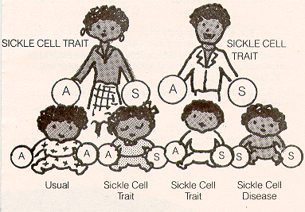
Sickle Cell Trait/Disease
Notes:
Autosomal dominant gene but displaying an autosomal recessive inheritance pattern = both parents must have trait to pass to children
One in four chance of child inheriting disease

Slide 76
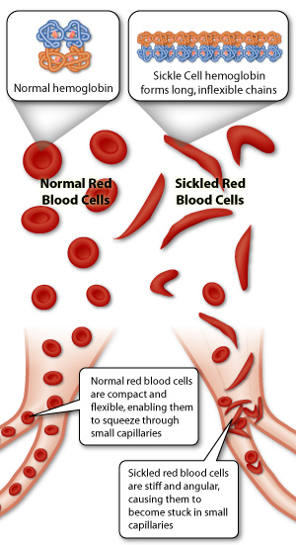
Sickle Cell Disease
Inherited defect in formation of Hbg
Red blood cells sickle
Sickled cells clump together
Notes:
Develops in second ½ of first year due to depletion of maternal stores
Lifelong dx
Occurs primarily in Blacks and persons of Mediterranean ancestry
Severe form results when gene is inherited from both parents
Red blood cells sickle when they are depleted of O2 and unsickle when they have O2 attached, so when O2 content is low in body RBC’s are more likely to sickle and stay that way
Sickled cells clump together; do not move well through small capillaries

Slide 77
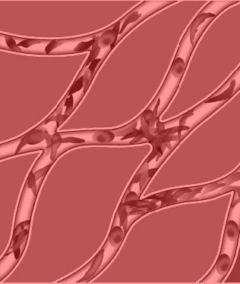
Sickle Cell Disease
Clumping leads to thrombosis and obstruction
Infarcts can develop: spleen, brain, heart, lungs, GI tract, kidneys, and bones
Sickling triggered by decreased oxygen or dehydration
Notes:
Primary symptoms are anemia and intense pain
Cells that sickle can’t pass through capillaries
Causing cells to clump in small vessels
Need to avoid triggers to prevent crisis
Parents MUST KNOW TRIGGERS and preventative measures

Slide 78
Avoid Sickling Triggers
Prevent loss of oxygen from tissues
Promote proper hydration
Avoid sources of infection
Avoid physical or emotional stress
Avoid exposure to temperature extremes
Avoid intense exercise
Notes:
Environments with low oxygen content (high altitudes, non-pressurized airplane flights)
Smoking
Recognize signs of dehydration Why would dehydration increase risk of sickling and clotting?
Avoid too much exposure to the sun
Provide access to fluids, both at home and away
Keep child properly immunized as recommended by the health care provider
Consider having the child wear a Medic Alert Bracelet
Share above information with teachers and other caretakers as appropriate
Demanding physical activity, especially if the spleen is enlarged
Emotional stress

Slide 79
Sickle Cell Disease: Symptoms
Drink excessively and urinate frequently (difficult to toilet train)
Chronic Anemia (Hbg 6 – 9 or lower)
Susceptible to infection
Growth retardation
Delayed puberty
Tachycardia
Joint swelling and BONE PAIN
Notes:
Body attempts to dilute concentration of RBC’s?
Sickling damages RBC’s, so they only live 15 – 20 days instead of 90 days
Pale mucous membranes and fatigue
Joints in fingers, hands, toes

Slide 80
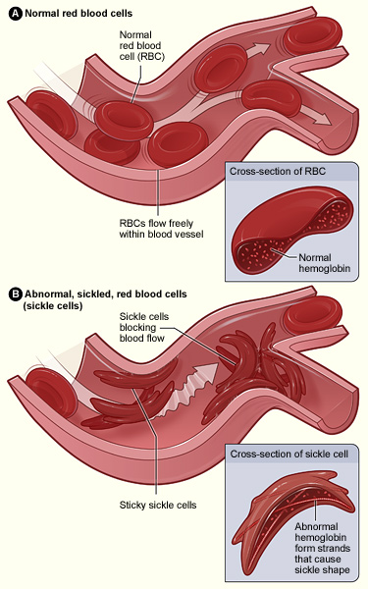
Sickle Cell Crisis
Overwhelming sickling of RBC’s
Occlusion of blood flow
Intense PAIN in involved areas
Notes:
Occurs periodically
Can be fatal
Patient appears acutely ill
Incidence decreases with age
Joint pain
Fever
Vomiting
Hematuria
Convulsions
Nuchal rigidity
Jaundice
Coma
Paralysis

Slide 81
Sickle Cell Crisis Treatment: Supportive and Symptomatic
Bedrest
O2 therapy
Analgesia
Antibiotics
Treat dehydration with IV fluids
Accurate I&O
Blood transfusion
Daily weights
Specific Gravity of urine
Monitor H&H
Nutritional support
Folic Acid
Move gently and support joints
Notes:
Bedrest to decrease O2 demands
Analgesic for pain
Blood transfusion replace sickled RBC’s with healthy RBC’s that can carry O2
Keep warm (affected areas)
Assess – facial expression, degree of restlessness, area of pain, S&S of dehydration, temp, pulse to determine if rapid or weak, sunken fonts in infant (Why? Dehydration)
SUPPORT JOINTS = PAINFUL

Slide 82
Sickle Cell Disease: Follow-up Care
Early treatment for impending crisis
Prevent of sickle cell crisis
hydroxyurea
Chronic pain management
Prevent infection
Prevent long-term complications
Folic acid supplement
Genetic counseling
Notes:
Death from organ system failure or infection
Need to prevent crisis from occurring (PREVIOUS SLIDE)
Some will have pain when not in crisis
Maybe prescribed long-term antibiotics to prevent infection. Need to ensure vaccines are up to date. Annual flu vaccine. Know S&S of infection and get treatment ASAP
Transcranial Doppler ultrasound = measures blood flow to and in brain; higher velocity = narrower blood vessels; if high velocity child is treated with a periodic blood transfusions to decrease risk of CVA
Folic acid to help support RBC production
Genetic counseling to prevent children from having disease.

Slide 83
Sickle Cell Disease: Long-term complications
CVA
PE
Liver and/or kidney damage
Sequestration of blood in spleen
Eye damage
Leg ulcers (adolescent and adult)
Chronic pain
Bone damage (necrosis)
Priapism
Notes:
Risk of CVA is 300 times more than average child
Patients are living longer with better prevention of crisis, treatment with blood transfusions, and antibiotics for infection.
Average life expectancy is 40 - 50 yrs. now
Some are having children
Pregnancy is difficult and dangerous for woman with sickle cell disease.
CVA, PE, and other clotting issues
Miscarriage from placental infarct
fetal growth retardation

Slide 84
Idiopathic Thrombocytopenic Purpura (ITP)
Hemorrhagic disorder
Marked decreased platelets
Excessive destruction of platelets
Common after upper respiratory infections
Decreased blood clotting
Notes:
Most common in 2 – 8 year olds
Cause Is unknown but is believed to represent an autoimmune response to disease related antigens
Occurs in one of two forms: acute or srlf limiting or chronic(longer than 6 mos)
Respiratory: or child hood disease of measles, rubella, mumps, or chicken pox or after the infection with human parvovirus( 5th disease)
Fever, rash joint pain

Slide 85
ITP: Signs & Symptoms
Easy bruising
Epistaxis
Bleeding gums
Hematuria
Hematemesis
Notes:
Platelet count less than 20, 000/mm3
No definite diagnosis several tests are performed to r/o other disorders ( lupus, lymphoma, leukemia)

Slide 86
ITP: Nursing Care
Prevent bleeding
Administer corticosteroids
PRBC’s
Gamma globulin (IVIG)
Splenectomy
No aspirin products
Notes:
Supportive therapy

Slide 87
Integumentary

Slide 88
Thrush
Caused by candida albicans
From fungal vaginal infection or from healthcare personal’s hands
Small white patches in mouth
Mycostatin is treatment
Swabbed in mouth several times daily
Diflucan is oral treatment
Can cause feeding difficulties
Notes:
Need to educate parents on care of nipples, bottles, pacifiers, and breasts
NO RE-FEEDING FROM BOTTLES
If breastfeeding, need to assess nipples for S&S of yeast and ALWAYS treat mother

Slide 89
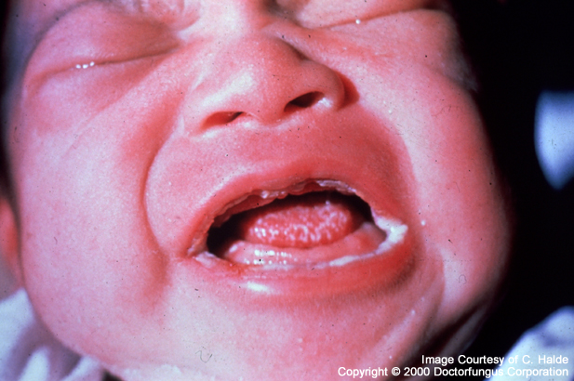
Thrush
Notes:
See white patches inside mouth and on tongue
Very painful
Difficult to feed

Slide 90
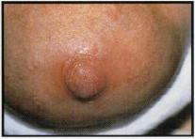
Remember Mother’s Breast
Notes:
Nipple is red, sore, itchy, with shiny, flakey skin
May have burning and pain with feeding

Slide 91
Impetigo
Staph infection or group A-beta-hemolytic strep
Causes vesicles or bullae
Isolation
Antibiotics
Notes:
Strep seen more in older children
Resistance to skin bacteria is low.
Vesicles or bullae rupture, causing superficial, moist open areas
Spreads by contact from one area to another or one person to another (girls at beach with Aunt Renee)
Need good hand washing
Highly contagious will require contact isolation if in hospital

Slide 92
Ringworm
Fungal infection that occurs on scalp, feet, and body
Transmitted by person to person contact
Via hats, combs, towels, mats
Small papule on skin that spreads
Develop scaly patches of baldness
Oral antifungal med for at least 3 months
Hair loss in not permanent
Notes:
Scaly rings with central clearing on body = may use topical tx
Scalp and feet are not responsive to topical tx must us oral
Can return to school once tx is started

Slide 93
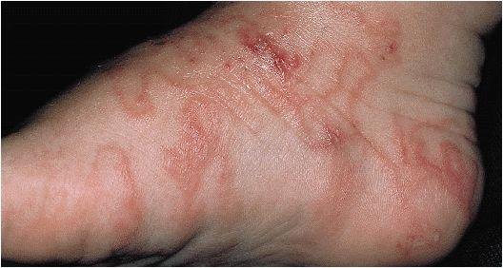
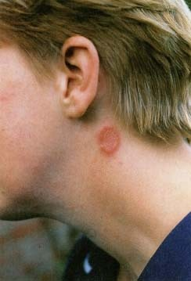
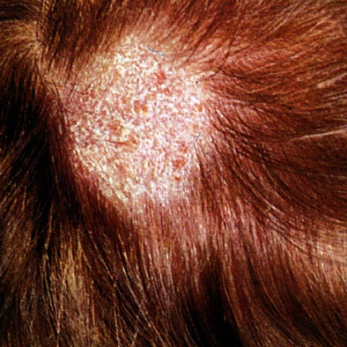
Tinea Pedis
Tinea Corporis
Tinea Capitis
Notes:
Capitus = head; Pedis = feet; Corporis = body
Ringworm of body is seen in wrestlers

Slide 94
Pediculosis (Lice)
Most common form of lice seen in children is head lice
Transmitted person to person
Severe itching is main symptom
Treatment
Shampoos: RID, Kwell
Manual removal of nites (eggs)
Inspect other family members/friends
Nurse should protect self by wearing gloves and hair coverings
Notes:
Can be transmitted by contaminated articles of clothing/bedding
Aim of treatment is ridding child of lice, treat excoirated skin, and prevent reinfestation

Slide 95
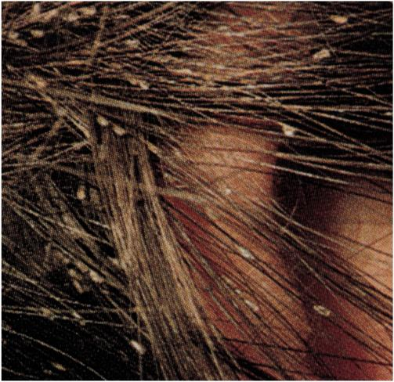
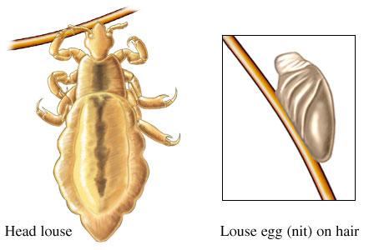
Notes:
Kids share hats, combs, brushes lice can easily transfer
Eggs look like shiny, transparent pearly whit flecks, tightly attached to hair follicle
Difficult to remove
Need to remove nits or will hatch and reinfest
Comb with fine tooth comb dipped in hot vinegar, helps to loosen

Slide 96
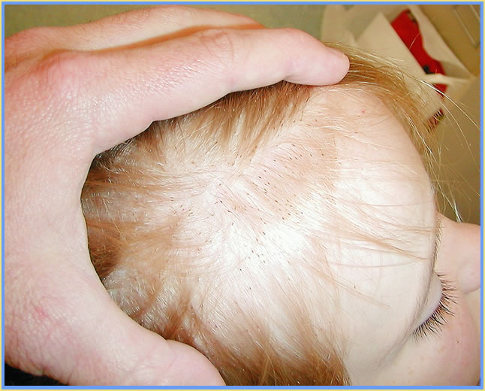
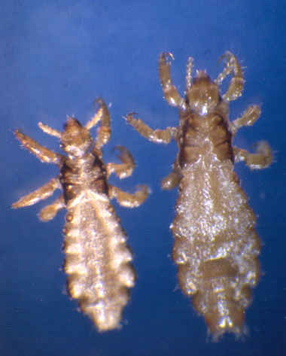
Notes:
Launder clothing and bedding in hot H2O and dry in dryer for 20 minutes
Teach child not to share and swap hats, etc.
Teach parents how to check child’s head
Any child with pubic lice think sexual abuse until otherwise R/O
Need to stay home until no lice or eggs are seen
Most schools require MD or nurse to check child before returning to school

Slide 97
Atopic Dermatitis
Infantile Eczema
Inflammation of skin
Hypersensitive response
Family history
Triggers
Allergens
Environmental irritants
Extreme temperature
Food sensitivities
Notes:
Dust mites, dander, mold
Smoke, soap, detergent, clothing
More in winter
See less with breastfeeding and delayed intro of solids

Slide 98
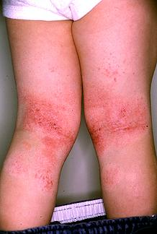
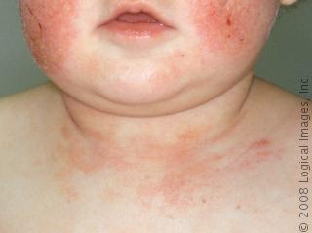
Atopic Dermatitis
Signs and Symptoms
Weeping and crusting vesicles
Itching
Easily infects
Seen on face and skin folds
Notes:
Infection with bacteria and/or viruses
Herpes simplex
Strep
Staph
May see flare-up after immunizations
See in warm moist areas

Slide 99
Atopic Dermatitis
Nursing Care
Goals
Maintain skin integrity
Maintain skin hydration
Decrease pruritus
ID and avoid triggers
Family education and support
Notes:
Avoid extremes in heat
Use tepid water for bathing
Limit time in water
Air-dry or pat dry with soft towel
Limit exposure to soap
Use mild detergent
Use loose cotton clothing and bedding
Moisturize skin while still moist
Corticosteroid creams
Keep nail short
Use mittens in younger child
Usually outgrow over time

Slide 100
Acne Vulgaris
One of most common health problems of teens
May be mild to severe with rope-like cystic lesions that leave deep physical and emotional scars
Causes
Heredity
Increased hormones
Blocked sebaceous glands trap sebum
Sebum becomes infected with anaerobic bacteria
Notes:
Acne is an anaerobic skin infection

Slide 101
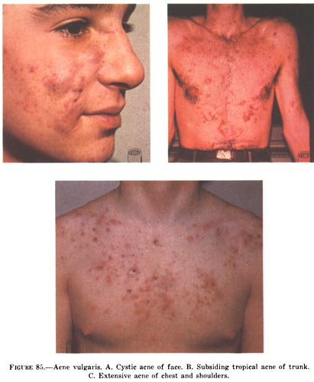
Acne Vulgaris
Treatment
Topical
Retinol A
benzoyl peroxide
benzoyl with antibiotic
Oral
Tetracycline
Accutane
Teratogenic
Monitor LFTs
Avoid sun exposure
Notes:
Nursing Diagnosis
Alteration in body image
Try topical first, then move to systemic antibiotics
Accutane is Vit A supplement
very teratogenic = recommend 2 types of birth control while taking
increases triglycerides
increase sensitivity to sun
Limit antibiotics to 2 – 4 months then change to topical
Nurse needs to assess individual level of distress
What appears mild to you maybe extremely distressing to adolescent
Nurse may underestimate importance to teen.

Slide 102
Burns and Children
70% happen to children 5 and under
Almost all are preventable
Causes
Scalding
Fire
Electricity

Slide 103
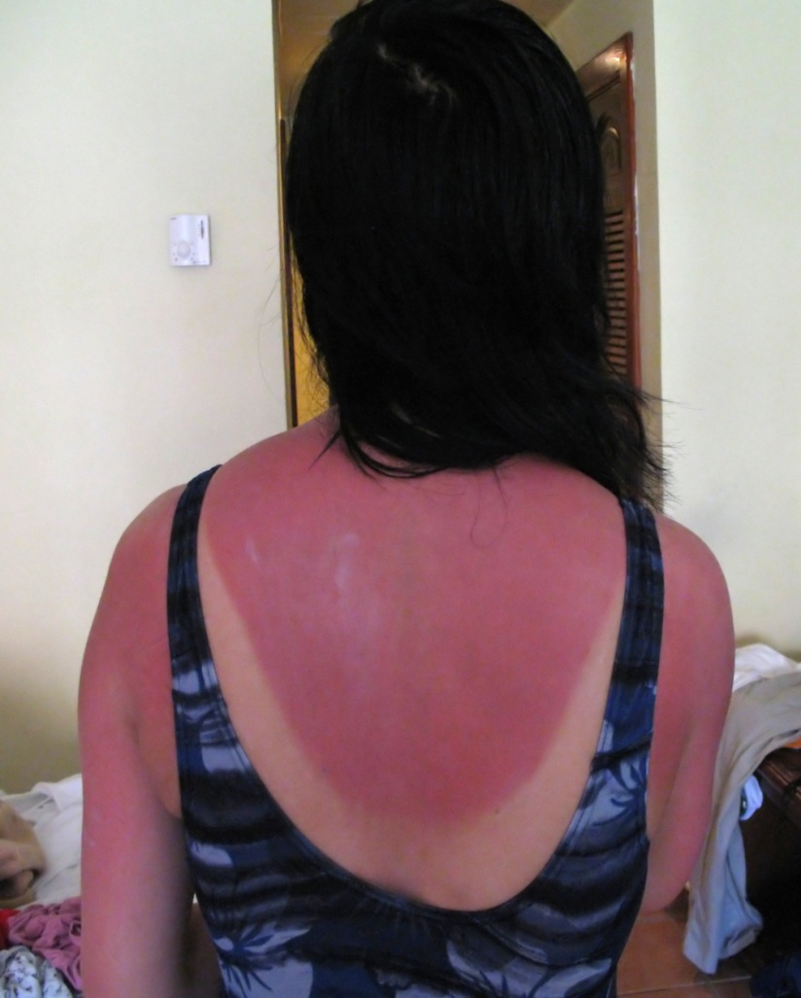
First Degree Burns
Epidermis injured
Erythema
Edema
Pain
Prompt regeneration
Notes:
Epidermis only no destruction of tissue or nerves
Sunburn

Slide 104
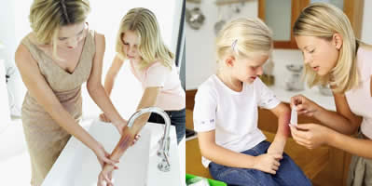
First Degree Burns Treatment
Immediate application of cold compress or submerge in cool water
Cleanse area
Apply anesthetic ointment
Cover with sterile gauze

Slide 105
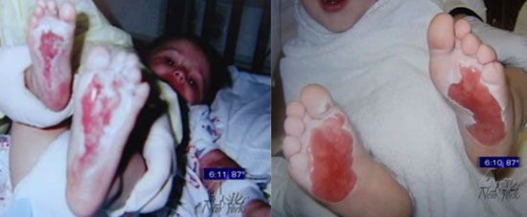
Second Degree Burns
Partial thickness
Epidermis and dermis injured
VERY PAINFUL
Mottled white to pink or cherry red
Blistering
Regeneration occurs slowly

Slide 106
Third Degree Burns
Total thickness
Epidermis, dermis, and nerve endings are destroyed
Mixed white to dark, charred looking
Skin appears dry with leathery eschar until debridement
Minimal pain
High risk of infection
Notes:
Worst of all
No pain because nerves destroyed or damaged
No barrier to prevent infection

Slide 107
Partial/Full Thickness Burns Treatment
Immediate application of cool compress
Remove clothing
if not stuck
if chemical cause
Hypovolemic shock
Notes:
Do not flush unless chemical
H2O = bacteria so not directly into open skin
Clothing will peel off tissues if stuck
Hypovolemic shock in first 48 hours
extracellular fluid rushes to burned areas
causing dehydration of body
edema at burn site, then hypovolemic shock

Slide 108
Partial/Full Thickness Burns Treatment
IV Fluids
Replacement
TPN
Airway
Inhalation injury may occur
Oral intake
NPO first 24 – 48 hrs.
May need NG tube
Notes:
GI tract has decreased blood flow d/t stress response and changes in blood flow
may see necrosis and mucosal edema with decreased motility and absorption

Slide 109
Partial/Full Thickness Burns Treatment
Diuresis
At 24 to 96 hrs post burn, body begins to reabsorb edema
Monitored urinary output closely
Renal shutdown is possible
Monitor fluid volume for overload
Notes:
Hypovolemic shock is first concern
Then after 24 to 96 hours concern changes to fluid overload and renal shutdown
I&O, daily weights, urine specific gravity
Breath sounds and resp status; watching for resp distress that may indicate pulmonary edema

Slide 110
Partial/Full Thickness Burns Treatment
Wound Care
Daily debridement is required
usually done through removal of old dsg.
Hydrotherapy to soak old dsg. and ease debridement
Topical medications
silver sulfadiazine (Silvadene)
gentamycin sulfate (Garamycin)
Grafting
Notes:
Need to cover wound as soon as possible
Usually done first with dsg.; Then skin grafts
Debridement is extremely painful, so PAIN MANAGEMENT IS IMPORTANT ISSUE
Scar tissue is also major concern as burns heal
Scar tissue can cause limitation in ROM (Contractures); especially over a joint

Slide 111
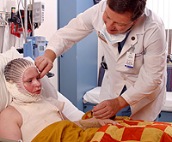
Partial/Full Thickness Burns Treatment
Infection Control
Protect from infection
Tetanus given
IV antibiotics
Sterile dressing changes
Reverse Isolation
Hydrotherapy
Notes:
Later complication
Hydrotherapy cleanses wound, loosens dsg. And helps debridement of wound

Slide 112
Infections

Slide 113
Reye’s Syndrome
Acute encephalopathy and fatty degeneration of liver and other abdominal organs
Occurs after viral illness treated with ASA
Symptoms appear 1 – 3 wks after illness
Staged from mild to severe
Mild = lethargy and confusion
Severe = seizures and coma
Diagnostic Studies
LFTs
Liver biopsy
Blood sugar
Notes:
See severe cerebral edema which causes most of S&S
Viral infection only (chicken pox or URI)
Parents may express concern about giving child ASA for other reasons
Seen mostly in school aged children
LFT’s are abnormal
Liver biopsy detects fatty degeneration
Hypoglycemia

Slide 114
Reye’s Syndrome Signs and Symptoms
Severe vomiting
Irritability
Hypoglycemia
Lethargy
Confusion
Progressive neuro status decline
Notes:
Immediate intervention necessary to prevent serious brain insult
Progressive neuro status decline with eventual respiratory arrest
Progress to coma and death

Slide 115
Reye’s Syndrome Nursing Care
Admitted to ICU
Supportive care
maintain neuro and respiratory function
Decrease cerebral edema
Control hypoglycemia
Early detection leads to better prognosis
Notes:
Low BS can cause seizures so monitor carefully
Great improvement if detected early and treatment started

Slide 116
Infectious Mononucleosis
Acute, self-limiting viral infection
General symptoms of viral infection
Mildly contagious
Transmitted through saliva
Diagnostic Studies
Monospot
Notes:
See most in extremely active teens
Poor nutrition and lack of rest make them more susceptible
Have highly close and intense relationships
Called “kissing disease”
May lead to spleenomeglia, if not treated.
Enlarged spleen may rupture; leading to hemorrhage

Slide 117
Infectious Mononucleosis
Symptoms
Malaise
Sore throat
Enlarged tonsils
Anorexia
Swollen lymph nodes
EXTREME FATIGUE

Slide 118
Infectious Mononucleosis
Nursing Care
Rarely hospitalized
Acute symptoms 7 to 10 days
Fatigue 2 to 4 weeks
Tylenol, rest, proper nutrition
Need reassurance
Watch for depression

Slide 119
Immunizations
See PowerPoint
Why immunize children?
Know recommended schedule
Check immunization status of every child at each visit (contact)
Address parental concerns
Acknowledge concerns
Explore concerns
Provide education to correct misconceptions
Offer accurate info
Notes:
Nurse responsibility to help keep child up to date on immunizations
Vaccines have been so successful that occasional adverse effects are greatly publicized
These reports and misinformation have lead to a growing anti-vaccine sentiment in our nation
More parents are refusing to have children immunized or are delaying immunizations
Last year had the highest incidence of measles in more than a decade
Parents feel that that they are unnecessary because risk for disease is low = true, but it is getting higher with more kids not immunized; diseases still prevalent in other parts of the world and international travel can bring dx back to US; measles epidemic in 2005 half of cases linked to one person who traveled to Europe and can back infected.
Health risks have gotten media attention
Link btw. MMR and autism
1998 study of 12 children (sample too small and some children had autism before receiving MMR) 10 of 13 authors have retracted their interpretation. Large better studies since have not supported this connection.

Slide 120
Psychosocial

Slide 121
Poisoning
High incidence in children
Toddlers most common group
Prevention, Prevention, Prevention
ID poison
Activate EMS/Contact poison control center
Nationwide Phone Number: 1-800-222-1222
Try to determine amount ingested
Remove poison from body, if appropriate
Notes:
Important to educate parents to prevent
If ingestion occurs; first step is to call poison control center 1-800-222-1222
Will ask what, when, how much, and child’s weight and age
Removal and/or treatment of poison depends on type of poison
Increased risk of occurring again if happens once
Teach parents to call poison control or EMS
They need to ID poison and determine amount ingested

Slide 122
Poisoning Signs and Symptoms
Depends on substance
Increased respirations
Acidosis
Electrolyte imbalance
Restlessness
Thirst
Fever
Sweating
Oliguria
Tinnitus
Tremors
Convulsions
Coma
Notes:
Most common S&S

Slide 123
Poisoning Treatment Options
Activated Charcoal
Gastric Lavage
Cathartics
Ipecac
Antidotes
Notes:
These are options for treatment
Choice depends on type of substance ingested and time from ingestion
Activated charcoal is odorless, tasteless, black powder give to absorb poison in stomach; may cause vomiting and aspiration; works best if given within 1 hour of ingestion
Gastric lavage = suctioning of poison with NG or OG tube; has little or no effect in reducing absorption (most recent lit review)
Cathartics = stimulate evacuation of bowel to remove poison and/or activated charcoal; WHY NOT? Risk of dehydration and electrolyte imbalance
No longer recommended to use ipecac syrup for home use; lack of clinical effectiveness and high association with adverse effects
Antidotes = counteract action of poison (Mucomyst = Tylenol; Narcan = opioids)

Slide 124
Child Abuse and Neglect
Approximately 1 million children annually
Risk Factors
3 months to 3 yrs. (Younger child = greater risk of death)
Toddlers at greatest risk
Children who are different in any way
Substance abuse
History of abuse in family
Child living in household with unrelated adult
High stress
Abuse cuts across ALL social and economic boundaries
Notes:
Most victims btw 3 months and 3 years
But remember children of all ages are subject to abuses
Children who are different = premature, hyperactive, CP, MR, unwanted pregnancy, boy vs. girl
There are also situational events that increase risk = unemployment, illness in family, residential changes, separation, divorce, constant stress and sorrow
50 times more likely to occur if child lives with an unrelated adult
If there is substance abuse in home, child is at increased risk for abuse
3 X’s more likely to experience abuse
4 X’s more likely to experience neglect

Slide 125
Child Abuse Definition
CAPTA (Child Abuse Prevention and Treatment Act)
any behavior directed toward a child by a parent, guardian, caregiver, or other family member or adult that endangers or impairs a child’s physical or emotional health and development

Slide 126
4 Categories of Abuse
Emotional Abuse
Physical Abuse
Sexual Abuse
Neglect

Slide 127
Emotional Abuse
Acts by parents or caretakers that cause or could cause behavioral, cognitive, emotional, or mental disorders
Difficult to verify
Wounds child’s spirit
Hit everyday with power of words
Destructive to self-confidence and self-esteem
Child feels worthless and inadequate
Notes:
Story
In Solomon Islands in south Pacific villagers build homes in trees.
If a tree is too tall for building and needs to be cut down they call a woodsman
Woodsman comes and screams at tree in a loud voice until tree dies
According to people who have been there, this works
When asked, villagers say that screaming kills the tree’s spirit
Now I don’t know about trees, but I do children and the same is true
“Sticks and stones may break my bones, but words will break my heart and my spirit
Especially cruel words from a parent!!!!
You are stupid, you moron, I don’t know why I ever had children, you are the reason I have no life
(Demeaning, shaming, threatening, blaming, intimidating, unfairly critical, or sarcastic)

Slide 128
Notes:
Role play parent yelling at a child
Have one student sit while other stands over them and yells at them
Ask student who was child to describe how they felt
This is what it feels like to be small and helpless, made to feel ashamed and intimidated
The 1995 movie The Little Princess has a great scene that demonstrates this. Miss Minchin is demeaning and shaming Sara and Sara begins to asserts herself. As she does the cinematography is brilliant. Sara becomes larger as Miss Minchin becomes smaller.
Remember children should be seen, heard, and believed

Slide 129
Physical Abuse
Involves physical injury
You may see
Unexplained injuries (fractures)
Repeated injuries
Marks on body for no known reason
Injuries appear to be grouped together, various stages of healing
Burns or bruises which show patterns of objects/shapes
Unlikely explanation from parents of injury
Behavior of child varies (hyperactive to withdrawn)
Notes:
Always suspect if injuries cannot be explained or if history does not match physical findings
KID IN ER WITH HEAD INJURY
Any bruises shaped like a recognizable object = spatula, cord, brush, belt, hand
Burn with pattern = cigarette, radiator
Unlikely explanation from parent; stories are inconsistent
Any delay in seeking care or injuries described as self inflicted or caused by a sibling
Limited ROM

Slide 130
Physical Abuse Assessment
Ask yourself
Is the history consistent?
Unchanged as related to various medical providers
Is the history plausible?
Could it happen given the child’s developmental capabilities?
Is the history compatible with injury?
Do the events match the physical signs?
Notes:
These are the keys to an accurate history and the way you rule in or out abuse.

Slide 131
Shaken Baby Syndrome
Occurs in infants < 18 months of age
Defining Characteristics
**Retinal hemorrhage**
Subdural or subarachnoid hematoma
Absence of other external injuries or signs of abuse
Breathing difficulties, seizures, dilated pupils, lethargy, and unconsciousness
Notes:
Extreme form of physical abuse
Usually < 12 months of age
Retinal hemorrhage is conclusive evidence in absence of good explanation (severe auto accident, fall from several stories onto a hard surface)
Subdural or subarachnoid hematoma from shearing of blood vessels

Slide 132
Sexual Abuse
Any kind of sexual behavior involving a child
Must be committed by a person responsible for child to be considered child abuse
If stranger = sexual assault
3 Categories
Physical = fondling and intercourse
Non-physical = indecent exposure, obscene phone calls, “Peeping Toms”, Internet, pornography
Violent = rape and other sexually violent behaviors
Notes:
Now we move into another realm
Sexual abuse is defined as exploitive sexual act or acts imposed on a child who lacks emotional, cognitive, and maturational development to deal with the actions
Incest = power imbalance in family, children fear authority. Are isolated from community
Denial exists = blurred inappropriate boundaries (KID IN CLINIC WHO’S STEPFATHER WAS TWEAKING HER NIPPPLE BUDS)
Only experienced members of a child abuse team should do vaginal exams

Slide 133
Sexual Abuse
Signs and Symptoms
Injury to genitals
Sexually transmitted disease in a young child
Repeat UTI’s in female child
New onset of bedwetting
Inappropriate and/or promiscuous sexual behavior
Discomfort with physical contact
Avoiding home or an individual
Notes:
Any child with GC, Chlamydia, etc. ….. SUSPECT
4 year old boy in Emily F’s daycare who talked about oral sex
Some questions that can be asked during routine physical well child check-up that can open door to sexual abuse issues.
How are beds arranged?
Who do children sleep with?
Who bathes children, do they keep door open or closed?
Bedroom doors open or closed at night?
Does either parent have trouble sleeping at night?
What do they do while they are awake?
Has anyone ever touched you in a way that made you feel uncomfortable?
Has anyone ever touched you in a way you did not like?

Slide 134
Neglect
Failure to provide for a child’s basic needs
3 Categories
Physical Neglect
Educational Neglect
Psychological Neglect
Notes:
Physical Neglect: not providing adequate food, clothing, medical care, supervision, may include abandonment
Educational Neglect: failure to provide appropriate schooling, such as special education needs and allowing excessive absences
Psychological Neglect: lack of emotional support and love

Slide 135
Non-Organic Failure to Thrive
Failure of an infant to grow and develop due to non-physical causes
Causes
Lack of parental attachment
No warm or close relationship with caregiver
Lack of interaction between caregiver and infant
Notes:
Usually a result of extreme neglect

Slide 136
Non-Organic Failure to Thrive
Signs and Symptoms
Listless
Low weight
Small size for age
Delayed development
Lays motionless for long periods
May avoid cuddling
Impaired family relationship
Rumination
Notes:
Parents/caregivers do not stimulate infant.
Infants have no one to respond to/stop trying to interact with environment
Rumination = infant behavior where infant or child self induces regurgitation and chewing food for a second time = way to self satisfy hunger
It is never too late for these children.
MD story baby born of drug dependent teen mother; severe failure to thrive; into protective custody with wonderful foster mother; baby recovered and thrived; still delayed B/C of prenatal drug abuse, but growing and developing.

Slide 137
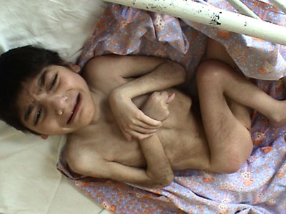
Notes:
This is a 7 year old boy found in a Romanian orphanage.
He is suffering from extreme neglect and failure to thrive.

Slide 138
Non-Organic Failure to Thrive Treatment
I&O
Calorie count
Daily weight
Sensory stimulation
Teach parenting skills
Role model
Talk positively about baby
Counseling
Placement of Infant
Notes:
Parents may not know how to parent
Parents may be depressed and need treatment
Rule out organic causes
Goal is for parents to develop nurturing behavior toward infant
Must establish trust btw. Parents and child
May need placement; if situation is unstable or parents cannot meet needs of infant
Great foster mom story

Slide 139
Child Abuse Reporting
Healthcare workers are MANDATED by state law to report any suspected child abuse
If injuries are not consistent with history, you MUST report
History is most essential part of investigation
Notes:
What do you do if you see and/or suspect any form of abuse?
REPORT IT!!!!
ALL 50 states now have mandatory reporting laws for suspected child abuse
Mandated means you must report even you only suspect
Curbside consultation example
Would you report this?
What should the provider do?

Slide 140
Child Abuse Reporting
Nationally
1-800-4-A-CHILD
In PA: CHILDLINE
1-800-932-0313
Notes:
Where or to whom do you report suspected abuse situations?
See Reporting Suspected Child Abuse: Roles and Responsibilities of Licensed Professionals at end of PP
You will need to know numbers for your area
Children and Youth Services of
Cumberland County (Carlisle)
West Shore Area
Dauphin County
York County
Anyone can report, but if you see and suspect abuse while you are working as a nurse, you MUST report

Slide 141
Child Abuse Reporting
Documentation
Essential
Factual
Opinion free
Accurate
May be used in court
May require removal of child into protective services
Notes:
Documentation is extremely important
Factual and opinion free
Accurately document injuries/wounds/behaviors/interactions
Exact locations, size, color; use a diagram of the body and draw in injuries
Take pictures, if able
Document direct quotes from parent, child, caregiver, witnesses, etc.
Remember this may be used in court to have child removed or to prosecute abuser(s)
If hospitalized it is best to have same caregiver at all times (develop trust)
Same sex if possible or opposite sex of abuser

Slide 142
Child Abuse Nursing’s role
Evaluation of child and family
Prevent abuse with teaching/counseling
Anticipatory guidance
Effective and appropriate discipline techniques
Report! Prevent further injury!
BELIEVE THE CHILD
Notes:
Prevention is most important aspect of this job
Educated parents about normal development, so they have realistic expectations
Recognize risk factors/families at risk
Teach parenting skills and role model behavior for them
Views on spanking are very personal and emotional
As a nurse we must promote positive discipline and not corporal punishment
Discipline means to teach
Punishment is a consequence for an unacceptable behavior
Punishment must fit the crime and developmental stage of child and must follow teaching
If you ever state to a parent that it is OK to spank, you will set yourself up for future litigation
This is your role
Always remember your role and stay within your boundaries
Need to develop trusting relationship with family; aid in teaching
You never know what a person considers spanking
You may think of a small quick tap on the bottom
They might think…

Slide 143
Alterations in Eating Patterns
Weight conscious society
Anorexia and Bulimia
Obesity
Measures by BMI or skin fold thickness
BMI between 85th and 95th = overweight
BMI > 95th = obese
BMI in 99th = extremely obese
Notes:
Anorexia and Bulimia
Two distinct disorders with different manifestations
Body mass index and skin fold thickness are most accurate way to diagnosis obesity at this time
BMI = ratio of weight in kg to the square of the height in meters kg/m2

Slide 144
Anorexia Nervosa
Characterized by
Refusal to maintain appropriate body weight
Intense fear of gaining weight or becoming fat
Disturbed self-image related to size/weight
Amenorrhea
Occurs primarily in girls
Affects 0. 5 % of American teenage girls
Notes:
Extreme weight loss or failure to gain expected weight for age and body type
Pathological fear of becoming obese, even though they are extremely underweight
Even when extremely underweight, they will still see themselves as “fat” or overweight; deny the seriousness of low body weight
In postmenarchal girls, this is the absence of 3 consecutive cycles.
Incidence has been slowly increasing since the 50’s.
About 5 – 10% are males
There also maybe a larger group of adolescents with partial sysmptoms

Slide 145
Anorexia Nervosa Typical Presentation
Child from model middle to upper class family
Average to superior intelligence
Usually overachievers
Expect perfection in all areas
Families have some degree of dysfunction
Patient’s illness serves to balance family
Notes:
Latest research supports genetic component with environmental “trigger”.
Adolescents with depression, perfectionist tendencies, anxiety and mood disorders are more likely to develop
Triggers:
pubertal hormone changes
social transitions (divorce, school changes, peer pressure, moving)
these make them feel “out of control” and they re-exert control by controlling eating and weight
Cultural expectations also appear to play a role (see more in industrialized countries).
Family dysfunction = overprotective, rigid, lack privacy, and inability to resolve conflicts

Slide 146
Anorexia Nervosa Signs and Symptoms
Weight loss may be gradual or sudden
Social withdrawal from food activities
Persistent and intense concerns with weight
May exercise excessively
Later, loses energy to participate in daily activities
Notes:
As weight drops, fear of being overweight increases
Refusal to eat with family and/or friends.
Refusal to attend social situations that involve food
Becomes isolated from family and friends, as they focus on controlling their eating and weight.

Slide 147
Anorexia Nervosa Physical Exam
Emaciated appearance
Dry skin
Amenorrhea
Lanugo
Cold intolerance
Low blood pressure
Low pulse
Abdominal pain
Constipation
Electrolyte imbalances
Notes:
These are seen in advanced cases
Remember bone mass reaches peak in adolescence; if not ingesting adequate Ca, may develop severe osteoporosis at a very early age; increasing risk of fractures; studies are showing that even gaining adequate weight can not make up for bone density loss

Slide 148
Anorexia Nervosa Nursing Care
Multidisciplinary team
Atmosphere is
relaxed and non-punitive
maintaining clear behavioral limits
Facilitate positive coping behaviors
Gradually increase autonomy, decision-making and improved body image
Continued work after discharge
Be alert to S&S
Prognosis uncertain
Notes:
Hospitalization criteria
Suicidal behavior
Weight > 30% lower than normal
Rapid wt loss
Hypothermia
Coexisting illness
Focus needs to be on restoring health and not just gaining weight
Family (parents) must be involved (Family therapy has been shown to be most beneficial)
Parents must deal with feelings of guilt, blame, and failure
Initial treatment can be long 1 to 2 yrs
May become a life-long problem for some patients.
Better prognosis, if treatment is started early
Relapses are frequent
Success rate is about 70%

Slide 149
Bulimia
Cycle of binge eating and purging
Expressed dissatisfaction with body size and/or weight
Occurs more commonly in older adolescent and young women
Binging is proceeded by anxiety
Treatment similar to anorexia, but involves pharmacological treatment
Nursing care includes management of anxiety
Notes:
Criteria for diagnosis = Binges occur at least twice a week for 3 or more months)
May also respond to binging with strict fasting, vigorous exercise, or abuse of laxative or diuretics
They are more aware that they have an eating problem, but are addicted to the cycle of binging and purging
1/3 have hx of anorexia nervosa
1/3 have hx of obesity
May or may not have weight loss
Frequent purging will eventually lead to malnutrition and electrolyte imbalance and may even lead to death.
Antidepressants : SSRI’s are drugs of choice

Slide 150
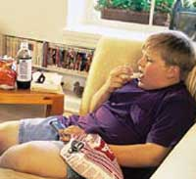
Obesity
17% of children and adolescents
Annual assessment of BMI
Lifestyle problem
Increased risk for chronic disease
Often subject of ridicule
Depression
Low self-esteem
Social isolation
Negative self-image
Notes:
Numbers are increasing every year
All children screened annually
Easier to prevent than treat
See trend in our society to increasing consumption of high calorie less nutritious diets with decreasing levels of physical activity
DM, HTN, Fatty liver disease, asthma
Miss more school days, have fewer friends, more likely to attempt suicide

Slide 151
Obesity
Children of obese parents are more likely to become obese
Treatment includes diet modification and exercise
Goals
Avoid weight gain during puberty
Weight remain stable as height increases
Diet needs to support growth
Notes:
Goal not to loss weight
Nutritional diet to support growth without gaining weight

Slide 152
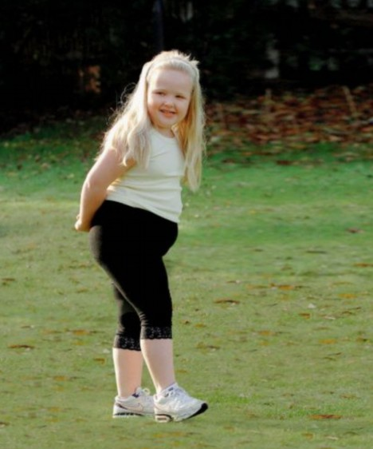
Obesity
Behavior modification
Support groups
Improve self-esteem
Medications
Bariatric surgery
Notes:
Must involve entire family to be successful.
Change eating habits and increase activity
Medication and gastric bypass as last resorts for extremely obese child and/or teen

Slide 153
Obesity
Nursing Care
Teach parents good nutrition
Encourage entire family to participate in physical activity
Encourage parents to limit time spent watching TV or playing video games to 2 hours/day
Prevention is paramount
Notes:
Low-income = encourage participation in WIC (nutritional counseling is part of program)
Encourage parents not to tease or ridicule overweight child, but to set a good example by eating healthy and exercising regularly
We see best results when entire family makes and keeps life style changes that support healthy weight for all family members
Get involved in your community to improve children’s diets and increase their access to fun and stimulating exercise

